Slide 1
AI-Driven Paradigm for Single-Cell Drug Resistance Prediction and Evaluation
Qing Wang, PhD student in BMI, HOBI, UF
Feb 25 2026
Contact: wang.qing@ufl.edu

Slide 2
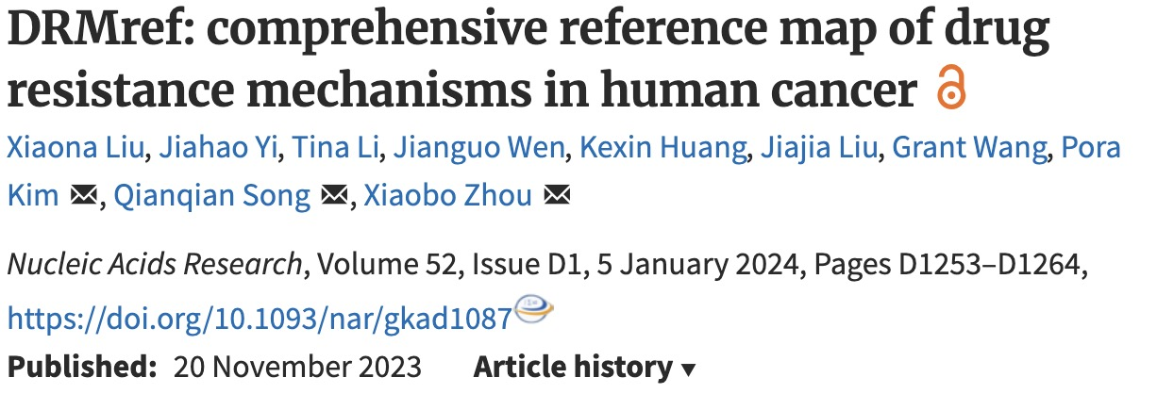
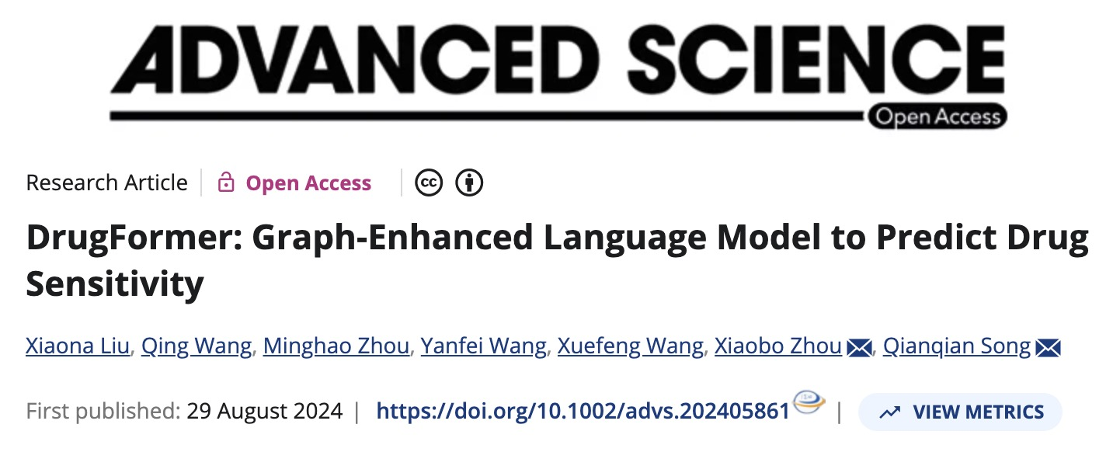
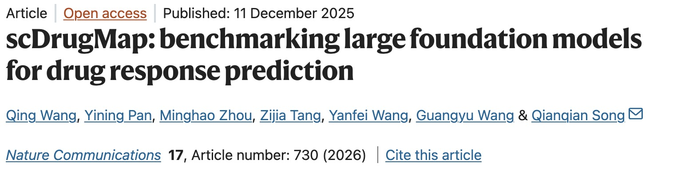
Data
Model
Benchmark

Slide 3

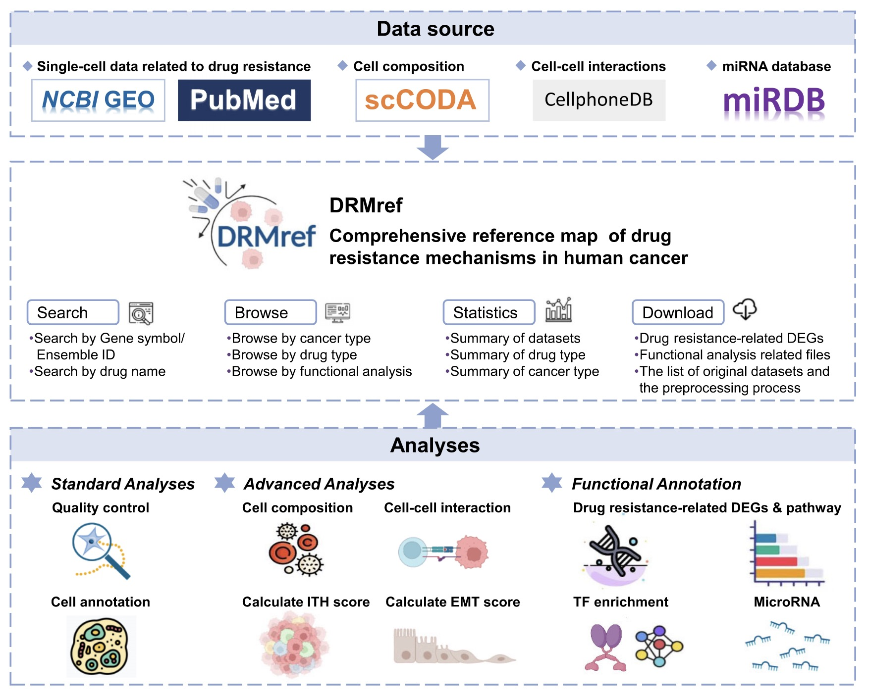
DRMref: comprehensive reference map of drug resistance mechanisms in human cancer
https://ccsm.uth.edu/DRMref/
Literature Mining: FDA drug matching and PubMed screening.
Data Acquisition: Curating scRNA-seq datasets from GEO.
Quality Control: Cell filtering and Seurat preprocessing.
Batch Integration: Removing technical noise via Harmony.
Cell Annotation: Marker-based typing and UMAP clustering.
Resistance Labeling: Assigning "Resistant" vs "Sensitive" status.
Mechanistic Analysis: Enrichment, ITH, and cell-cell communication.

Slide 4
DRMref: comprehensive reference map of drug resistance mechanisms in human cancer

Slide 5
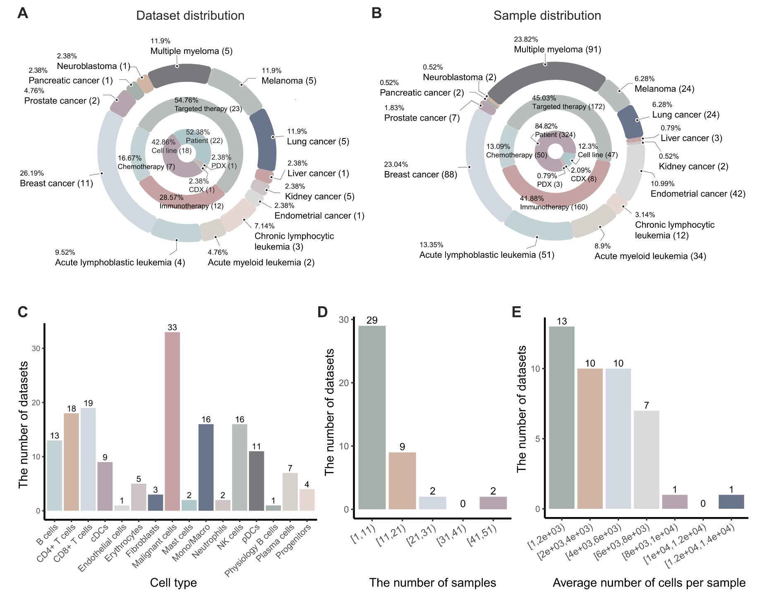
DRMref: comprehensive reference map of drug resistance mechanisms in human cancer
42 scRNA datasets
30 studies
382 samples
1646974 cells
13 major cancer types
35 treatment regimens
42 drugs

Slide 6
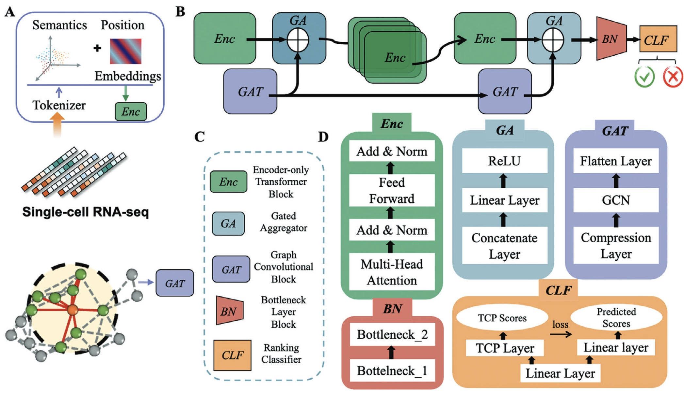
DrugFormer: Graph‐Enhanced Language Model to Predict Drug Sensitivity

Slide 7
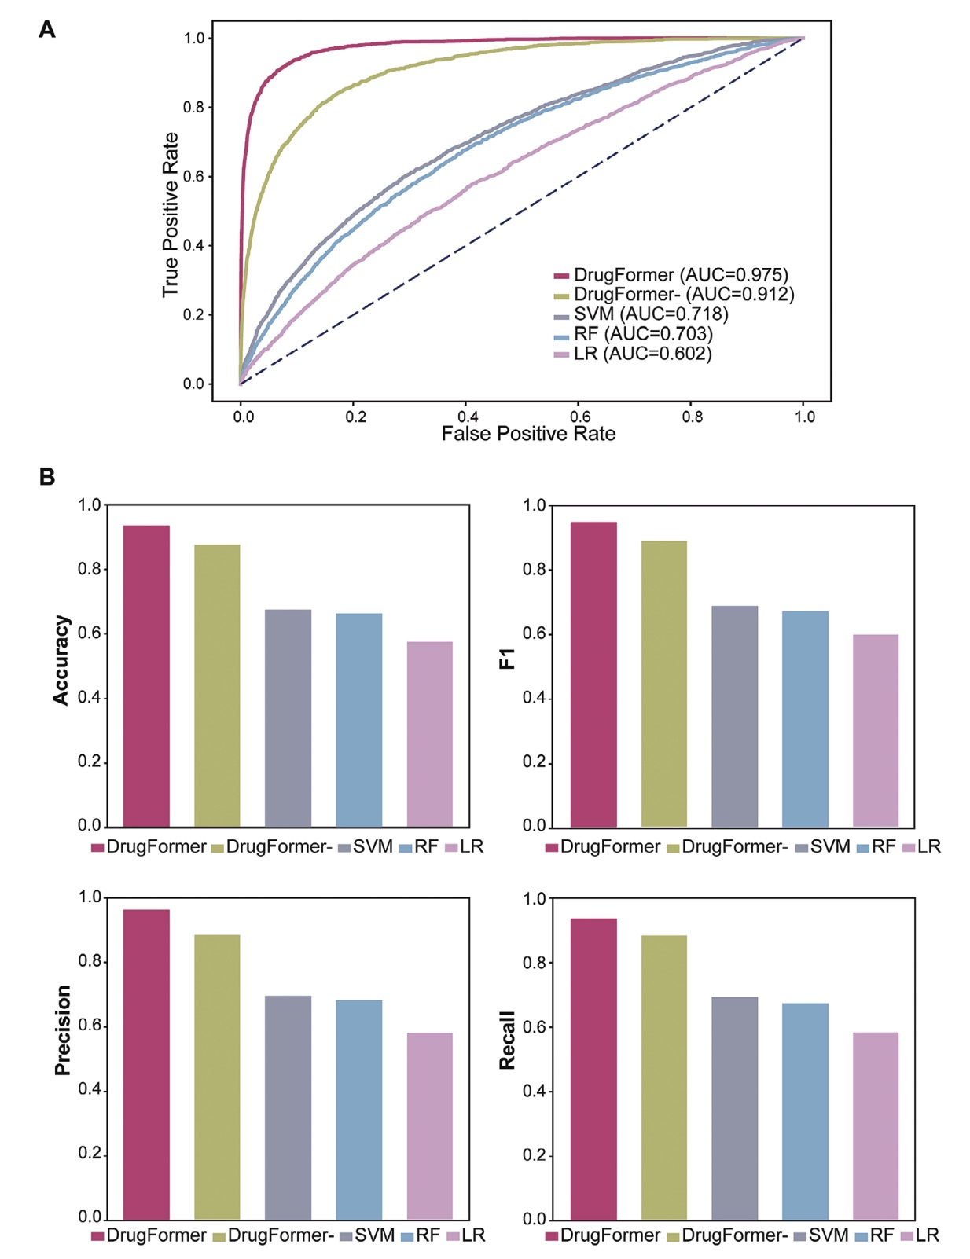
DrugFormer: Graph‐Enhanced Language Model to Predict Drug Sensitivity

Slide 8
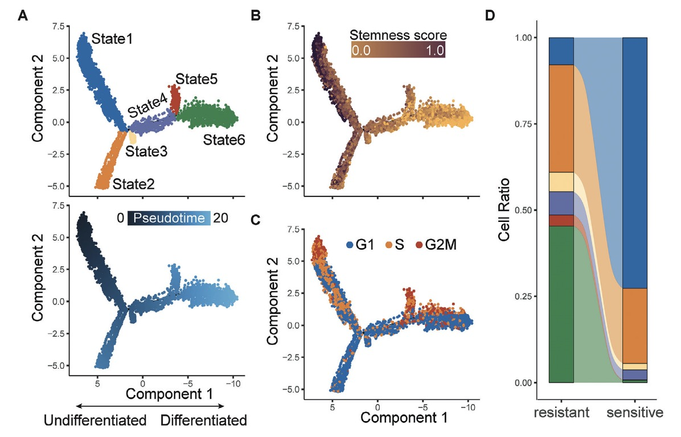
DrugFormer: Graph‐Enhanced Language Model to Predict Drug Sensitivity
Identification of resistant cell state in multiple myeloma

Slide 9
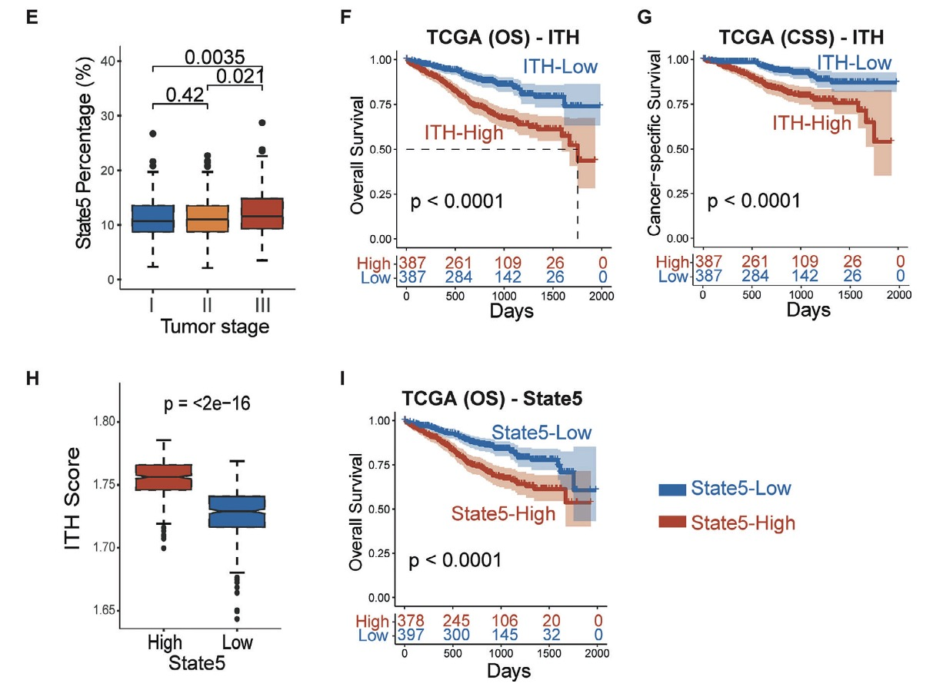
DrugFormer: Graph‐Enhanced Language Model to Predict Drug Sensitivity
Identification of resistant cell state in multiple myeloma

Slide 10
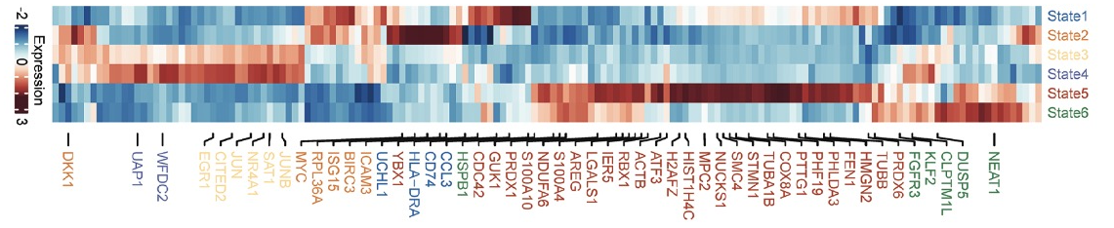
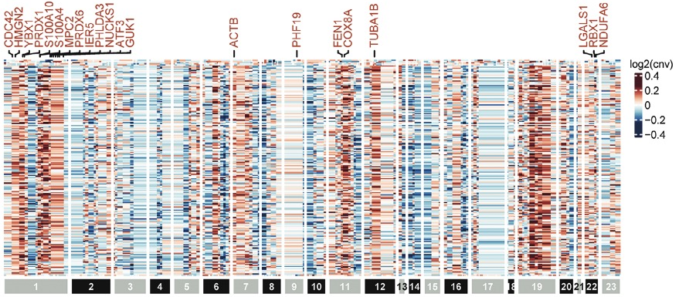
DrugFormer: Graph‐Enhanced Language Model to Predict Drug Sensitivity
Underlying mechanisms of resistant cell state in MM.

Slide 11
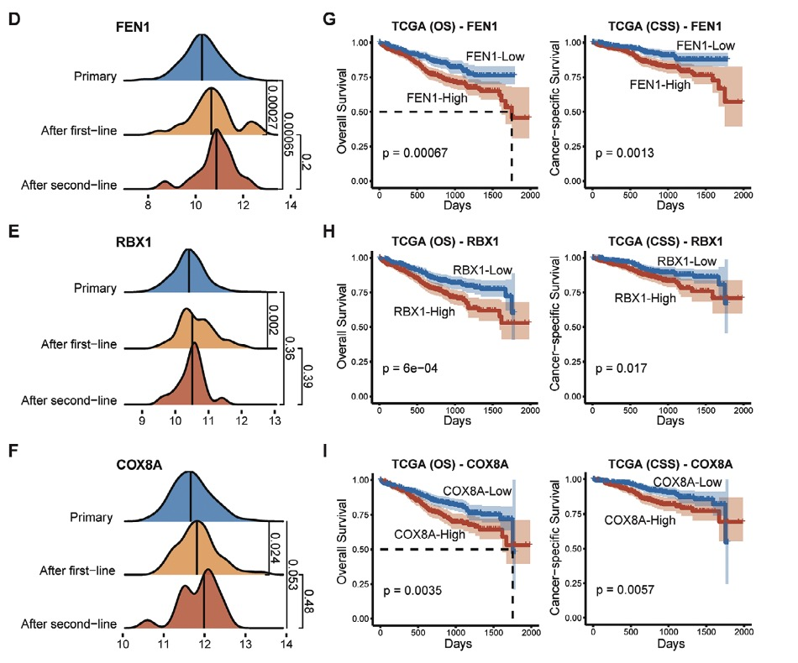
DrugFormer: Graph‐Enhanced Language Model to Predict Drug Sensitivity
Underlying mechanisms of resistant cell state in MM.

Slide 12
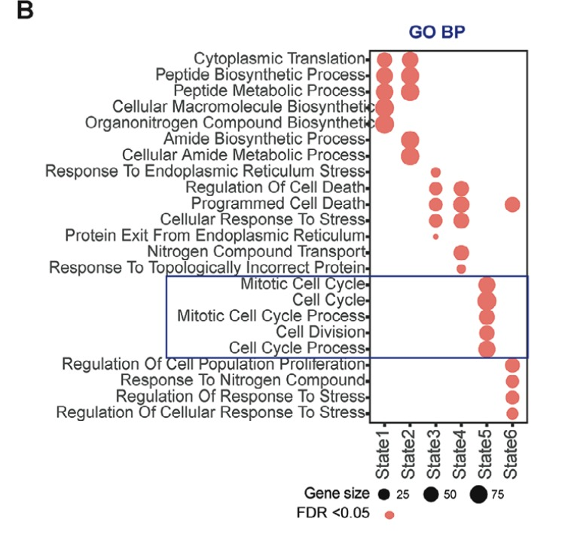
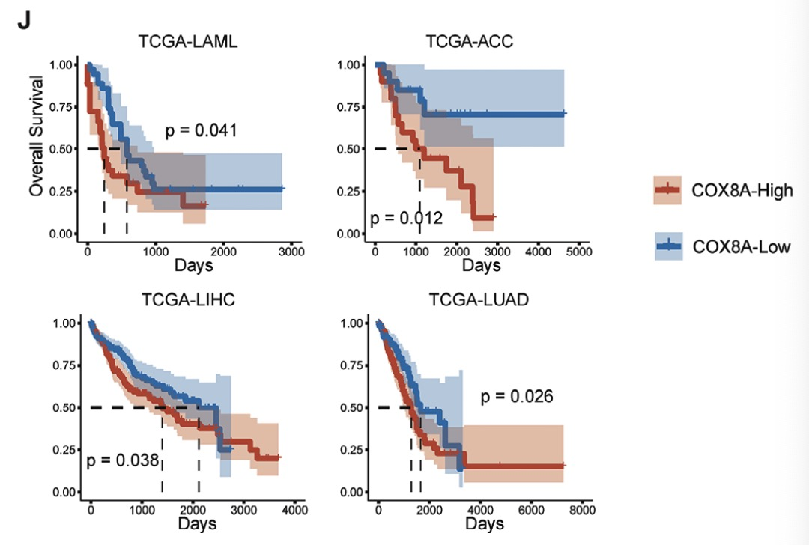
DrugFormer: Graph‐Enhanced Language Model to Predict Drug Sensitivity
Underlying mechanisms of resistant cell state in MM.

Slide 13
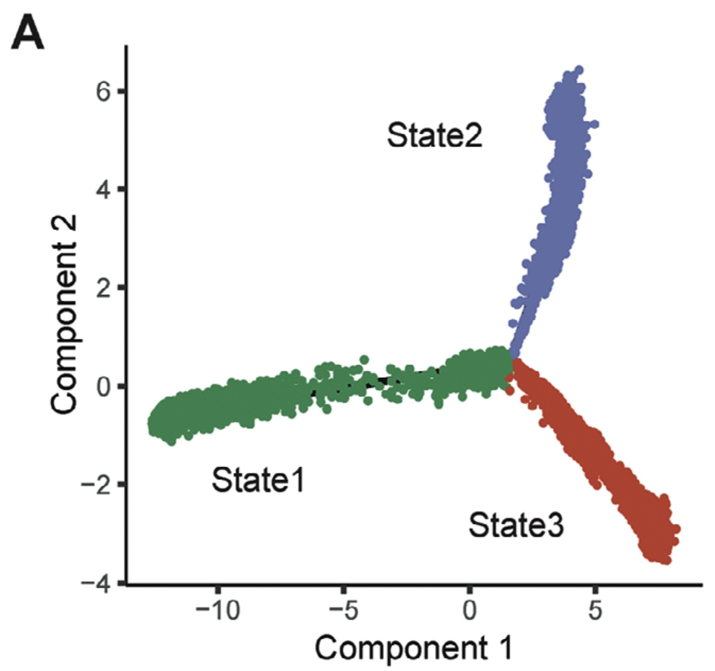
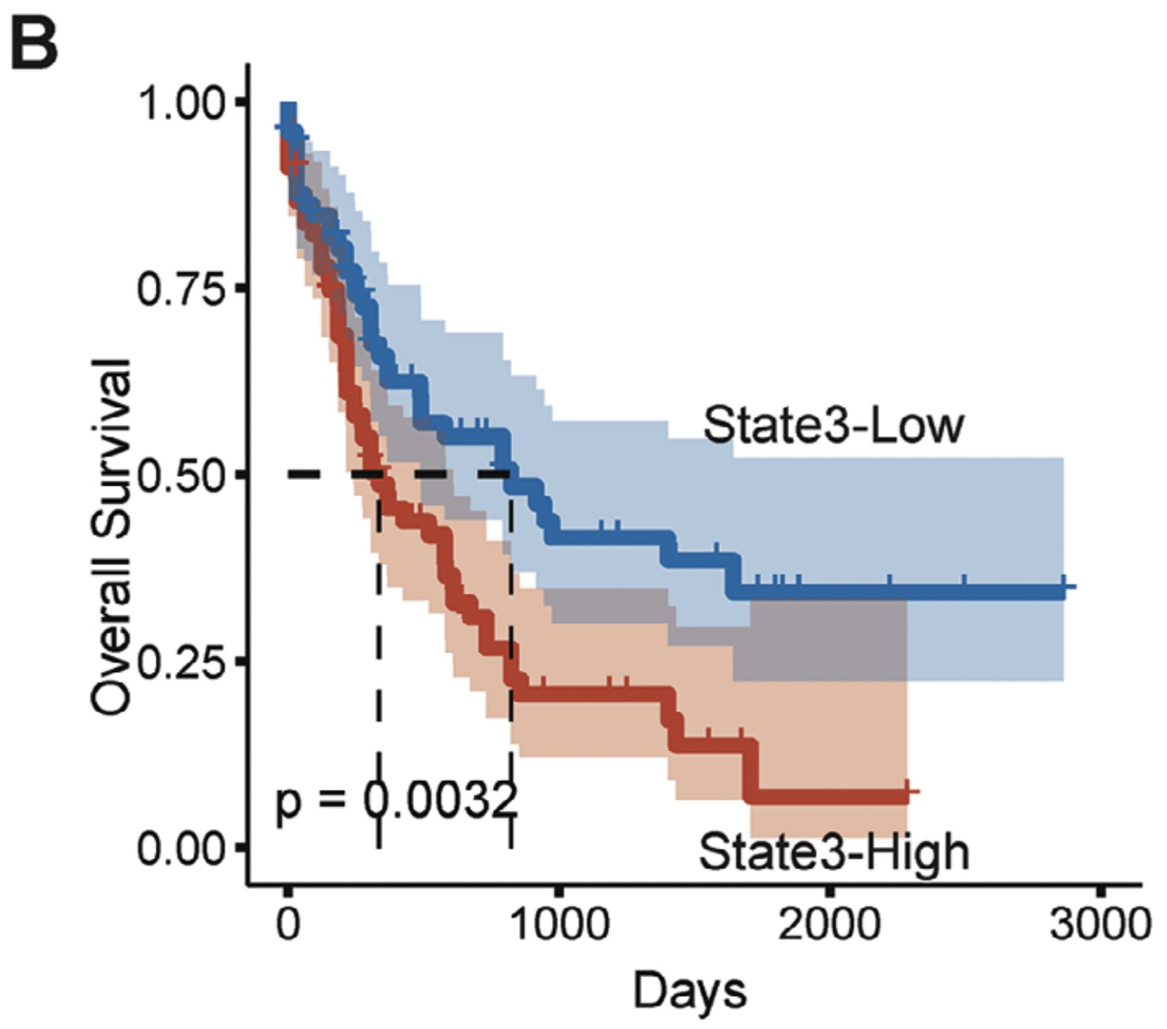
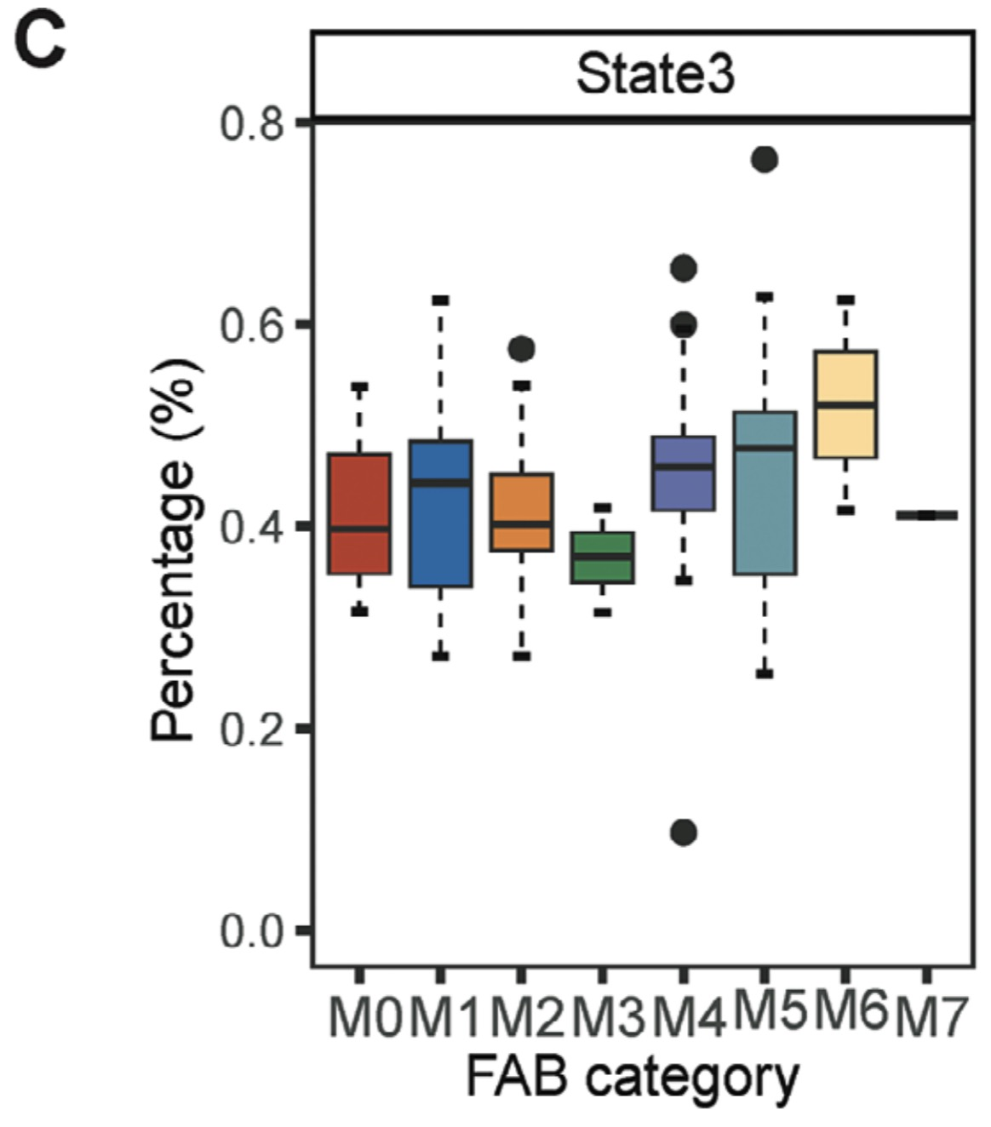
DrugFormer: Graph‐Enhanced Language Model to Predict Drug Sensitivity
Resistant cell state of acute myeloid leukemia.

Slide 14
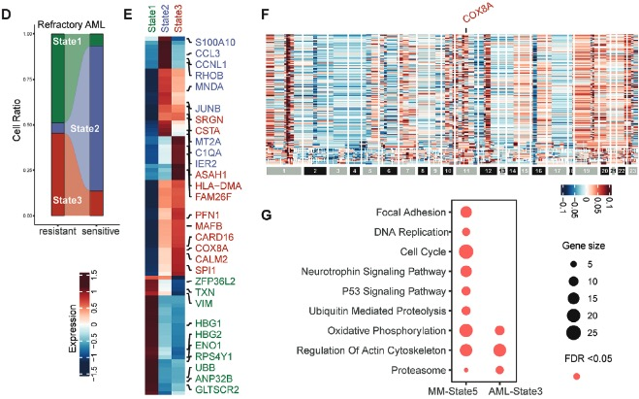
DrugFormer: Graph‐Enhanced Language Model to Predict Drug Sensitivity
Resistant cell state of acute myeloid leukemia.

Slide 15
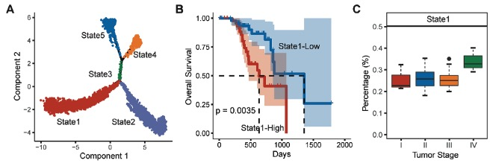
DrugFormer: Graph‐Enhanced Language Model to Predict Drug Sensitivity
Resistant cell state of melanoma.

Slide 16
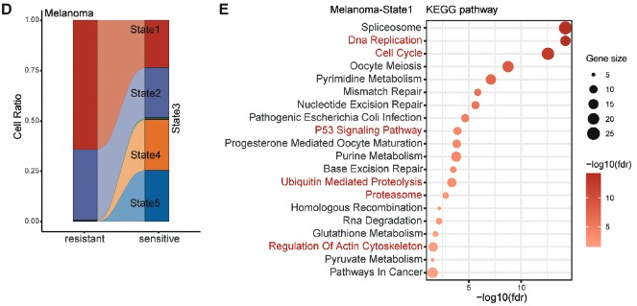
DrugFormer: Graph‐Enhanced Language Model to Predict Drug Sensitivity
Resistant cell state of melanoma.

Slide 17
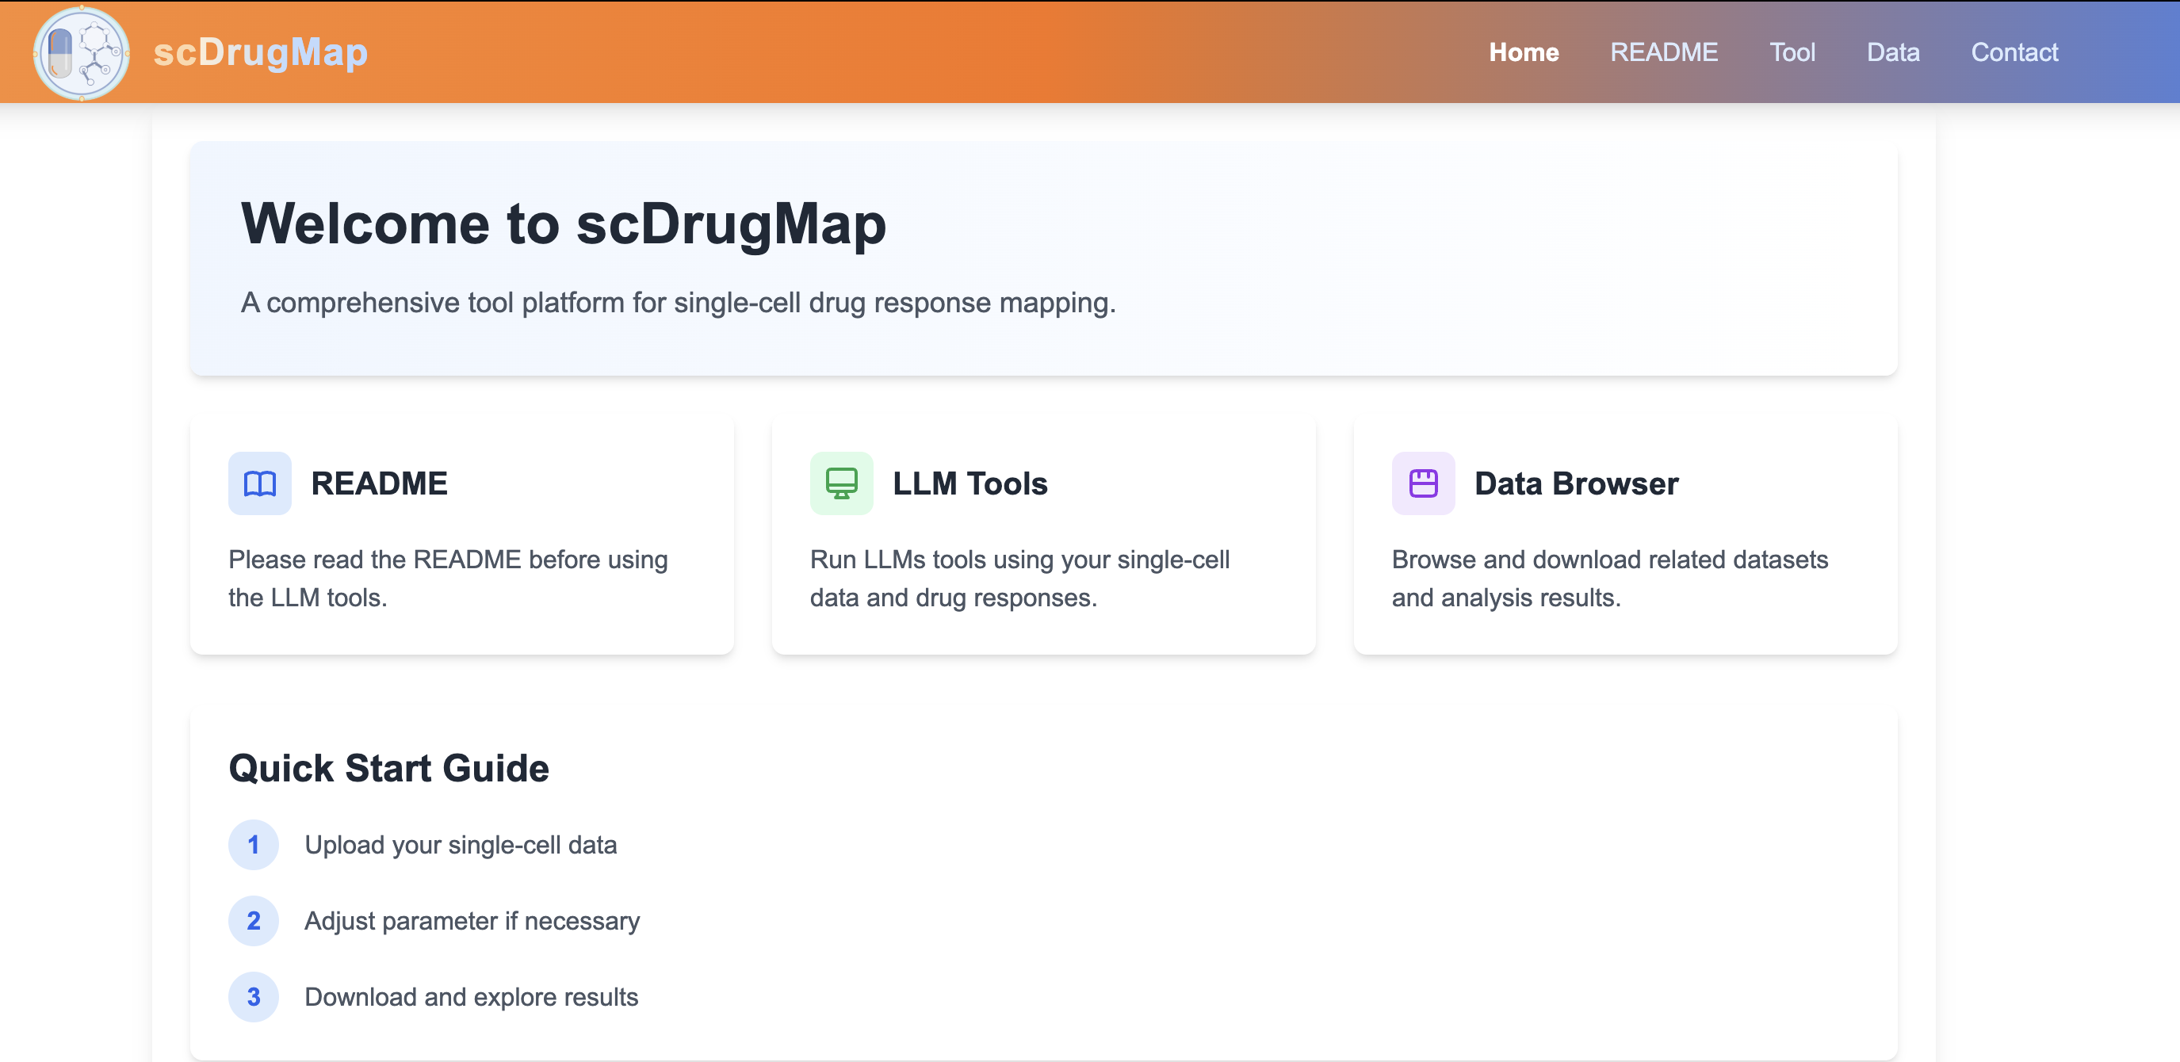
scDrugMap: Benchmarking Large Foundation Models for Drug Response Prediction
https://github.com/QSong-github/scDrugMap

Slide 18
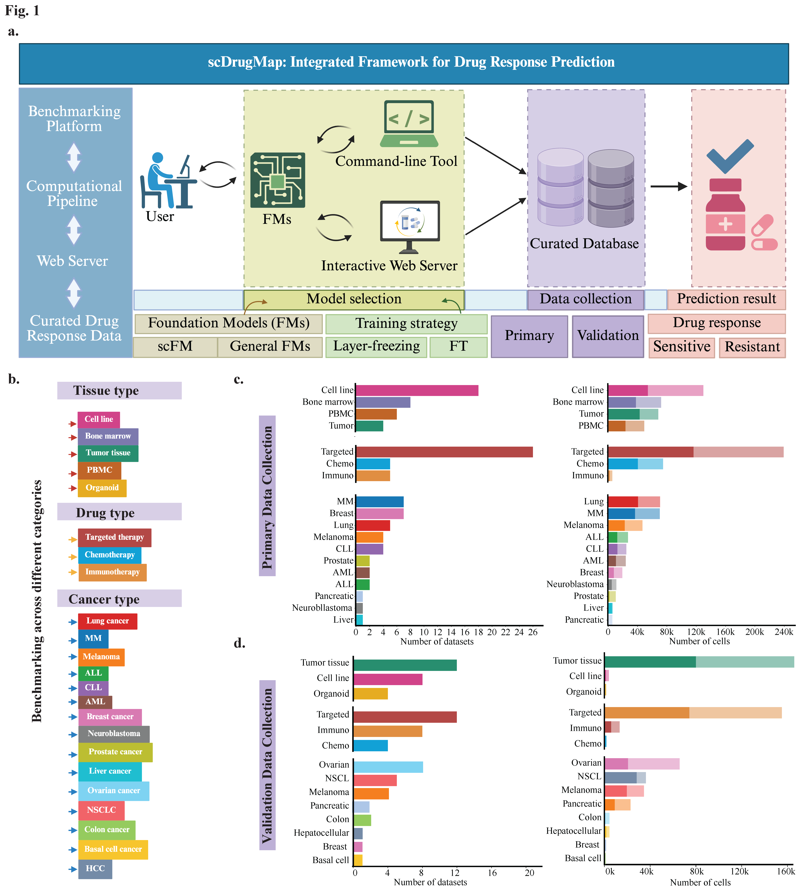
scDrugMap: Benchmarking Large Foundation Models for Drug Response Prediction
Overview of the scDrugMap framework.

Slide 19
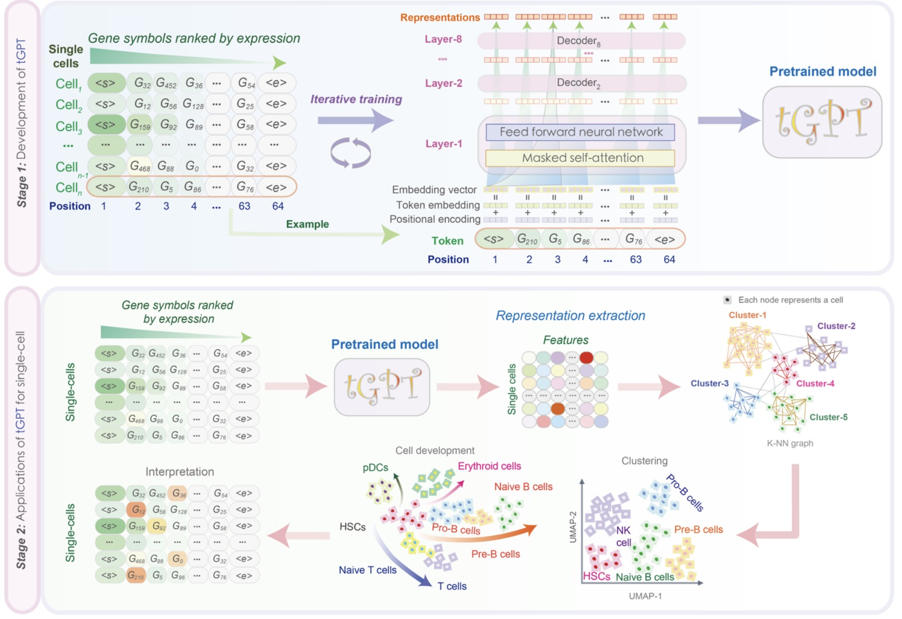
scDrugMap: Benchmarking Large Foundation Models for Drug Response Prediction
tGPT
~2.2 M single‑cell RNA‑seq
top‑N gene‑ranking sequences
GPT‑like Transformer decoder
next gene token prediction
Self‑supervised autoregressive training
Shen, H., Shen, X., Hu, J., Liu, J., Zhang, C., Wu, D., ... & Li, X. (2022). Generative pretraining from large-scale transcriptomes: Implications for single-cell deciphering and clinical translation. bioRxiv, 2022-01.

Slide 20
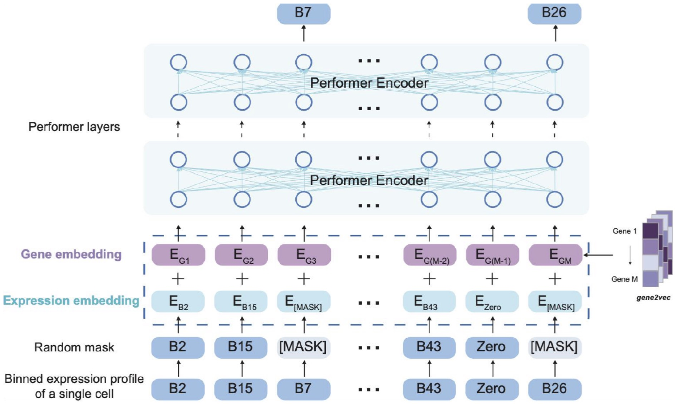
scDrugMap: Benchmarking Large Foundation Models for Drug Response Prediction
scBERT
Over 1M unlabeled scRNA‑seq corpora from multiple organ
Labeled datasets with known cell‑type annotations for evaluation and fine‑tuning
Transformer encoder (BERT‑style)
gene2vec
Masked Language Modeling (MLM)
Yang, F., Wang, W., Wang, F., Fang, Y., Tang, D., Huang, J., ... & Yao, J. (2022). scBERT as a large-scale pretrained deep language model for cell type annotation of single-cell RNA-seq data. Nature machine intelligence, 4(10), 852-866.

Slide 21
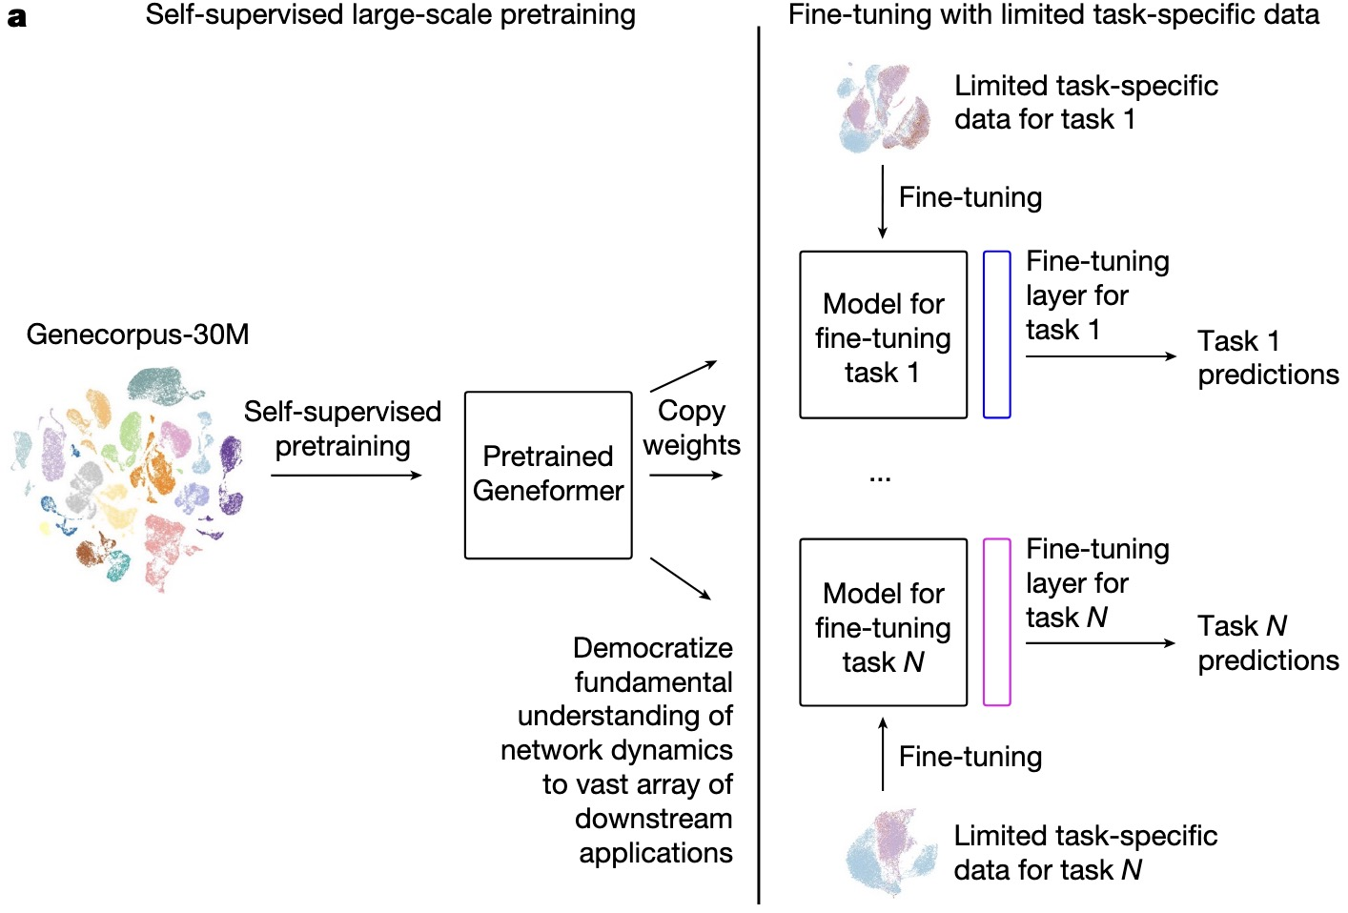
scDrugMap: Benchmarking Large Foundation Models for Drug Response Prediction
Geneformer
~3 M single‑cell transcriptomes
rank-value encoding
non-zero genes
Transformer‑based model
self-supervised masked objective: mask ~15% genes
Theodoris, C. V., Xiao, L., Chopra, A., Chaffin, M. D., Al Sayed, Z. R., Hill, M. C., ... & Ellinor, P. T. (2023). Transfer learning enables predictions in network biology. Nature, 618(7965), 616-624.

Slide 22
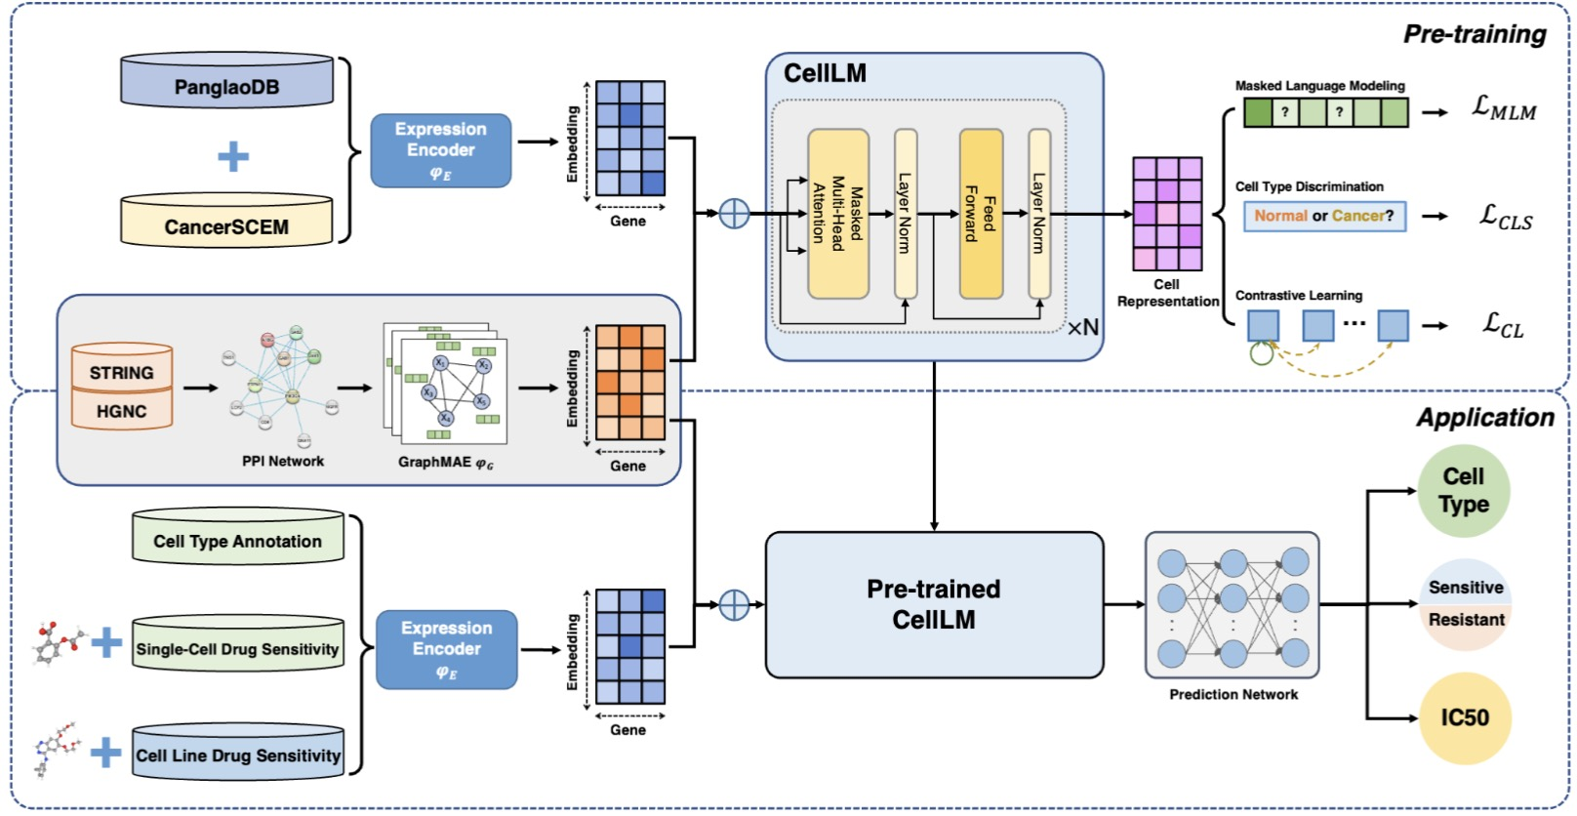
scDrugMap: Benchmarking Large Foundation Models for Drug Response Prediction
CellLM
~2 M single‑cell profiles from both normal and tumor datasets
Expression encoder / Gene encoder / Performer
Contrastive: two stochastic views (dropouts) of the same cell are pulled together; different cells pushed apart.
MLM: mask expression bins and predict the original bins.
CLS: classify each cell as tumor or normal.
Zhao, S., Zhang, J., & Nie, Z. (2023). Large-scale cell representation learning via divide-and-conquer contrastive learning. arXiv preprint arXiv:2306.04371.

Slide 23
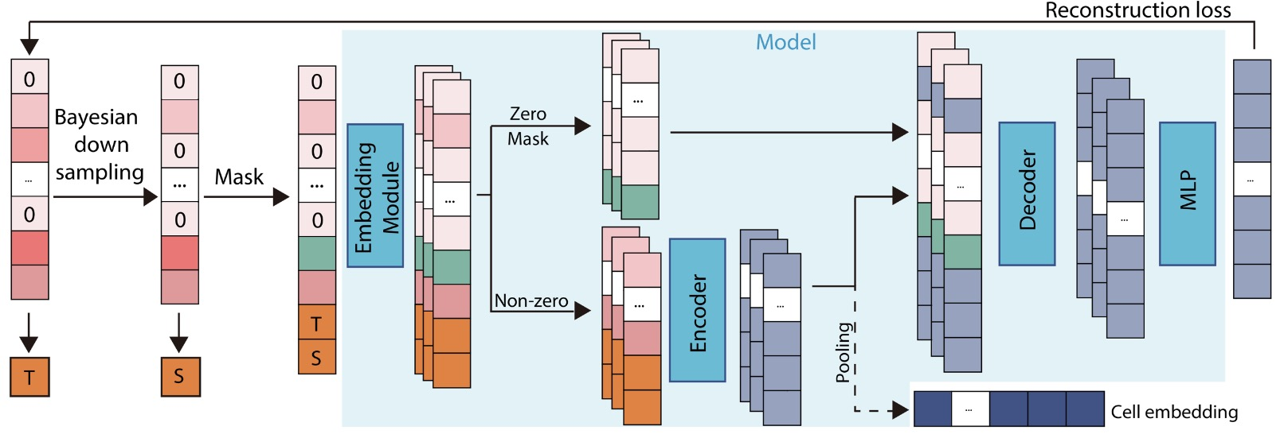
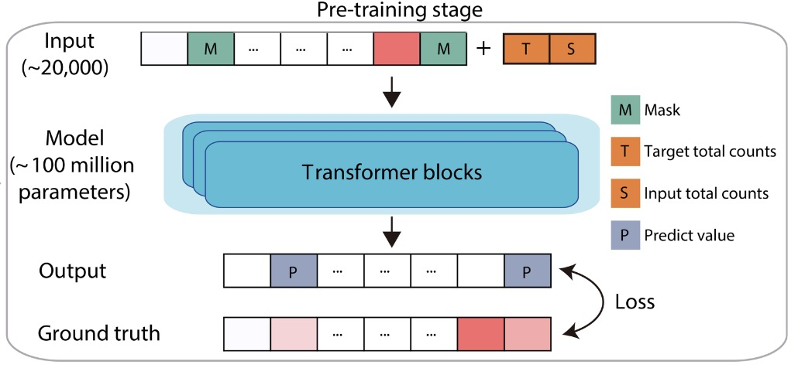
scDrugMap: Benchmarking Large Foundation Models for Drug Response Prediction
scFoundation
over 50 M human single cells (largest), covering ~19–20k genes
focusing on human biology (100 tissues)
Asymmetric encoder–decoder
continuous value embeddings; gene embeddings; special embeddings for zero and mask values
Read‑depth‑aware pretraining
masked positions prediction
Hao, M., Gong, J., Zeng, X., Liu, C., Guo, Y., Cheng, X., ... & Song, L. (2024). Large-scale foundation model on single-cell transcriptomics. Nature methods, 21(8), 1481-1491.

Slide 24
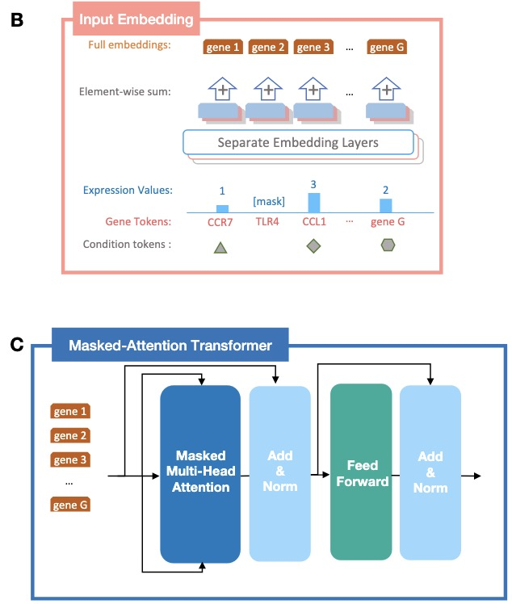
scDrugMap: Benchmarking Large Foundation Models for Drug Response Prediction
scGPT
over 33 million single-cell sequencing data
spanning 55 organs/tissues and 441 studies
GPT‑like model (masked attention)
gene tokens, binned expression values, and condition tokens
Generative self‑supervised pretraining
Cui, H., Wang, C., Maan, H., Pang, K., Luo, F., Duan, N., & Wang, B. (2024). scGPT: toward building a foundation model for single-cell multi-omics using generative AI. Nature methods, 21(8), 1470-1480.

Slide 25
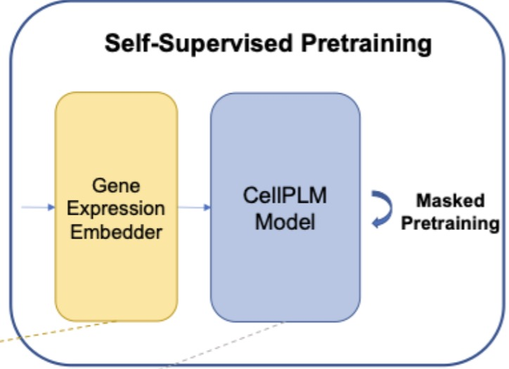
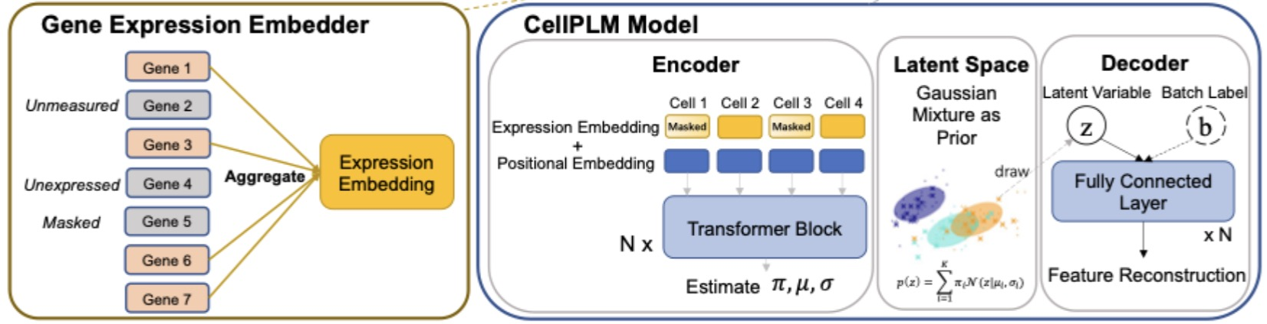
scDrugMap: Benchmarking Large Foundation Models for Drug Response Prediction
CellPLM
~ 9 Million scRNA-seq cells and 2 Million SRT cells
Transformer‑based encoder–decoder
Performer‑style
Cell-Tissue->Token-Sentence
Cell‑level masked language modeling
Wen, H., Tang, W., Dai, X., Ding, J., Jin, W., Xie, Y., & Tang, J. CellPLM: Pre-training of Cell Language Model Beyond Single Cells. In The Twelfth International Conference on Learning Representations.

Slide 26
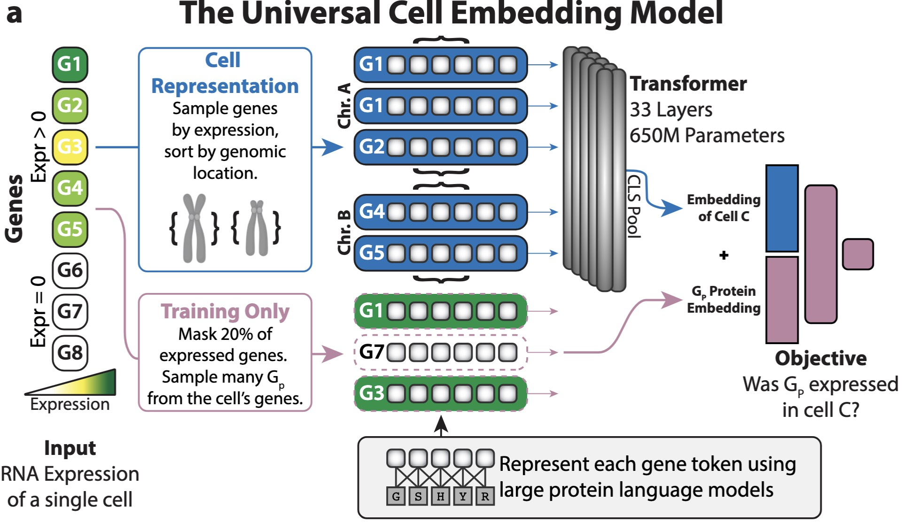
scDrugMap: Benchmarking Large Foundation Models for Drug Response Prediction
UCE
>36M cells from 300+ datasets and 8 species
tokenized via ESM2 protein embeddings
33‑layer Transformer
self‑supervised (mask 20%)
predict whether the gene is expressed
Rosen, Y., Roohani, Y., Agarwal, A., Samotorčan, L., Tabula Sapiens Consortium, Quake, S. R., & Leskovec, J. (2023). Universal cell embeddings: A foundation model for cell biology. BioRxiv, 2023-11.

Slide 27
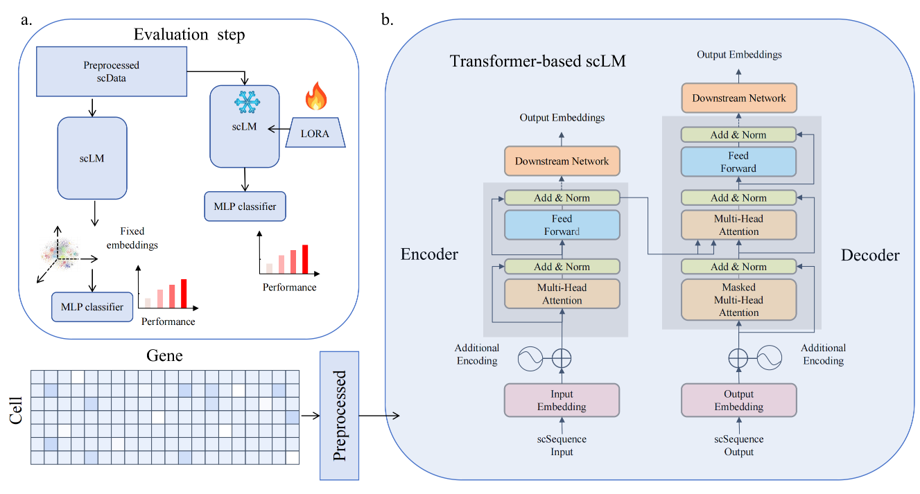
scDrugMap: Benchmarking Large Foundation Models for Drug Response Prediction

Slide 28


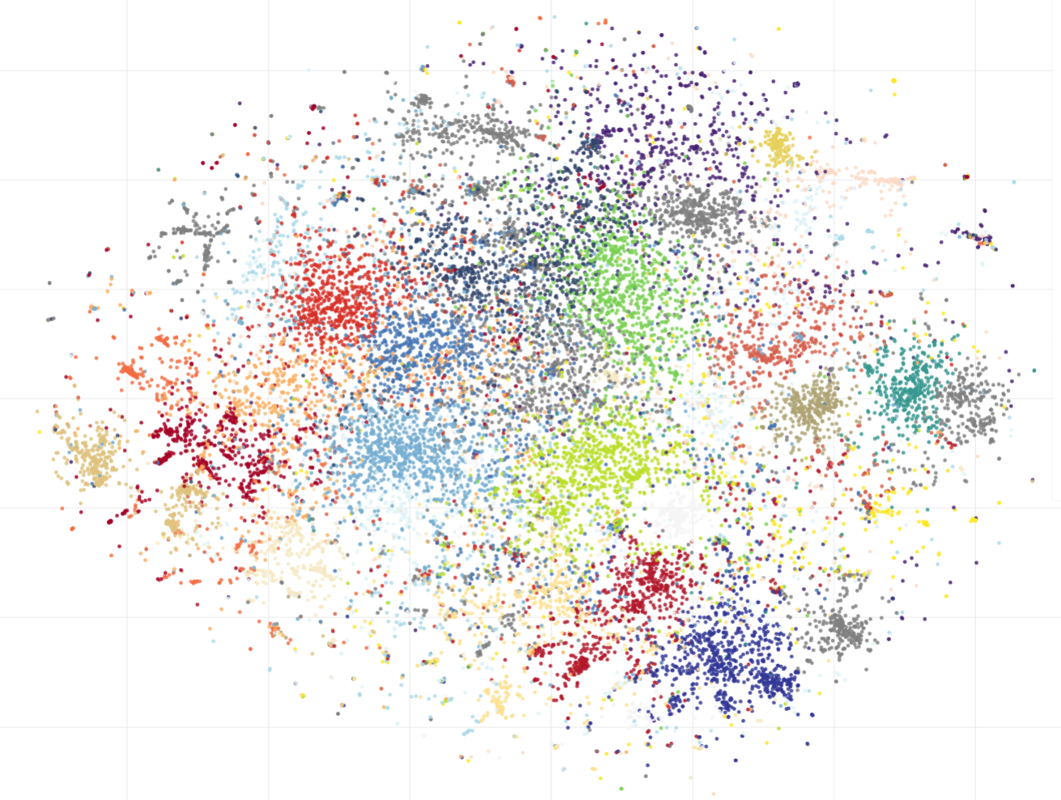
scDrugMap: Benchmarking Large Foundation Models for Drug Response Prediction
“GENE1 GENE2 GENE3 GENE4….”
LLama3-8B
LLama3-8B
Top1024 ranked gene names
Fixed embedding only
MLP
gene symbols as words
Fixed embeddings
MLP classifier
Performance

Slide 29
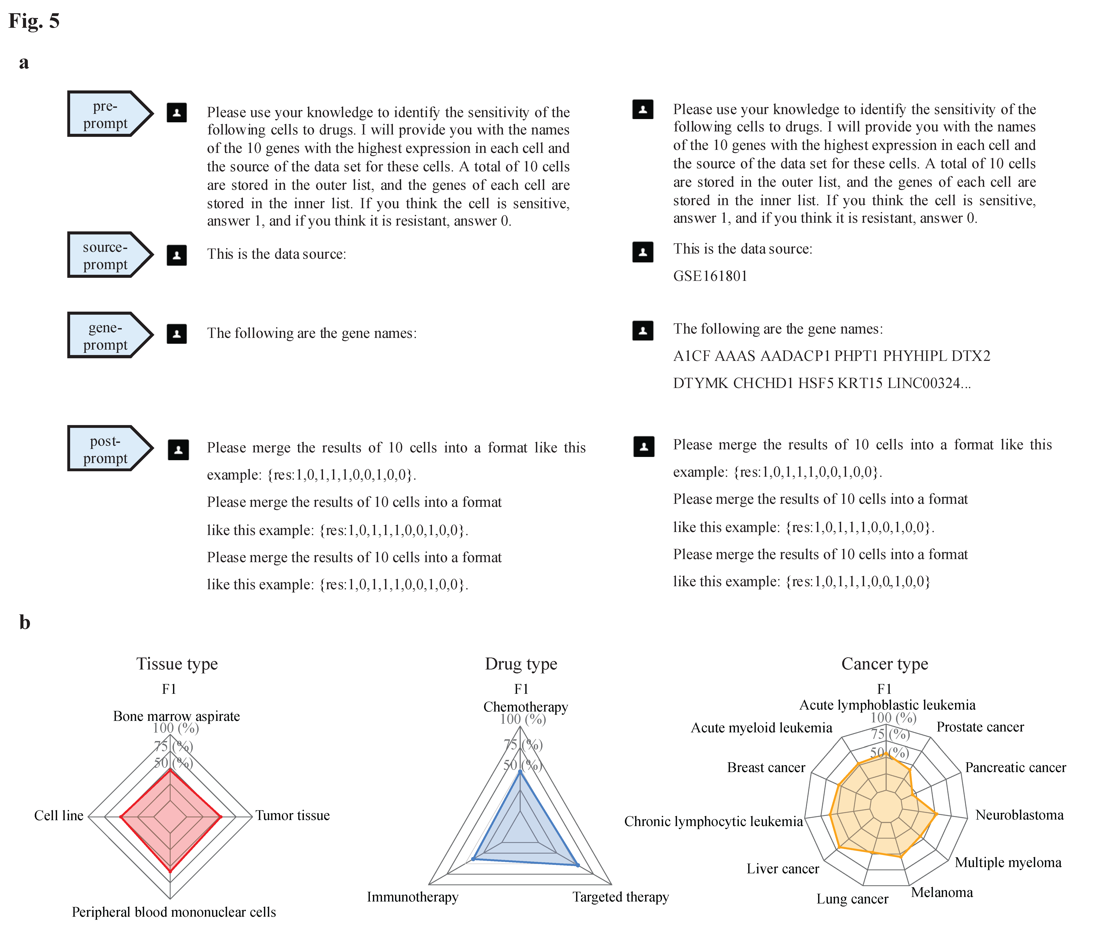

scDrugMap: Benchmarking Large Foundation Models for Drug Response Prediction
GPT4o-mini
Top 10 ranked gene names
Prompt
In Context Learning
gene symbols as words

Slide 30
scDrugMap: Benchmarking Large Foundation Models for Drug Response Prediction
Overview of the scDrugMap curated datasets.
326,751 primary cells
168,486 validation cells
5 tissue types
3 drug types
15 cancer types

Slide 31
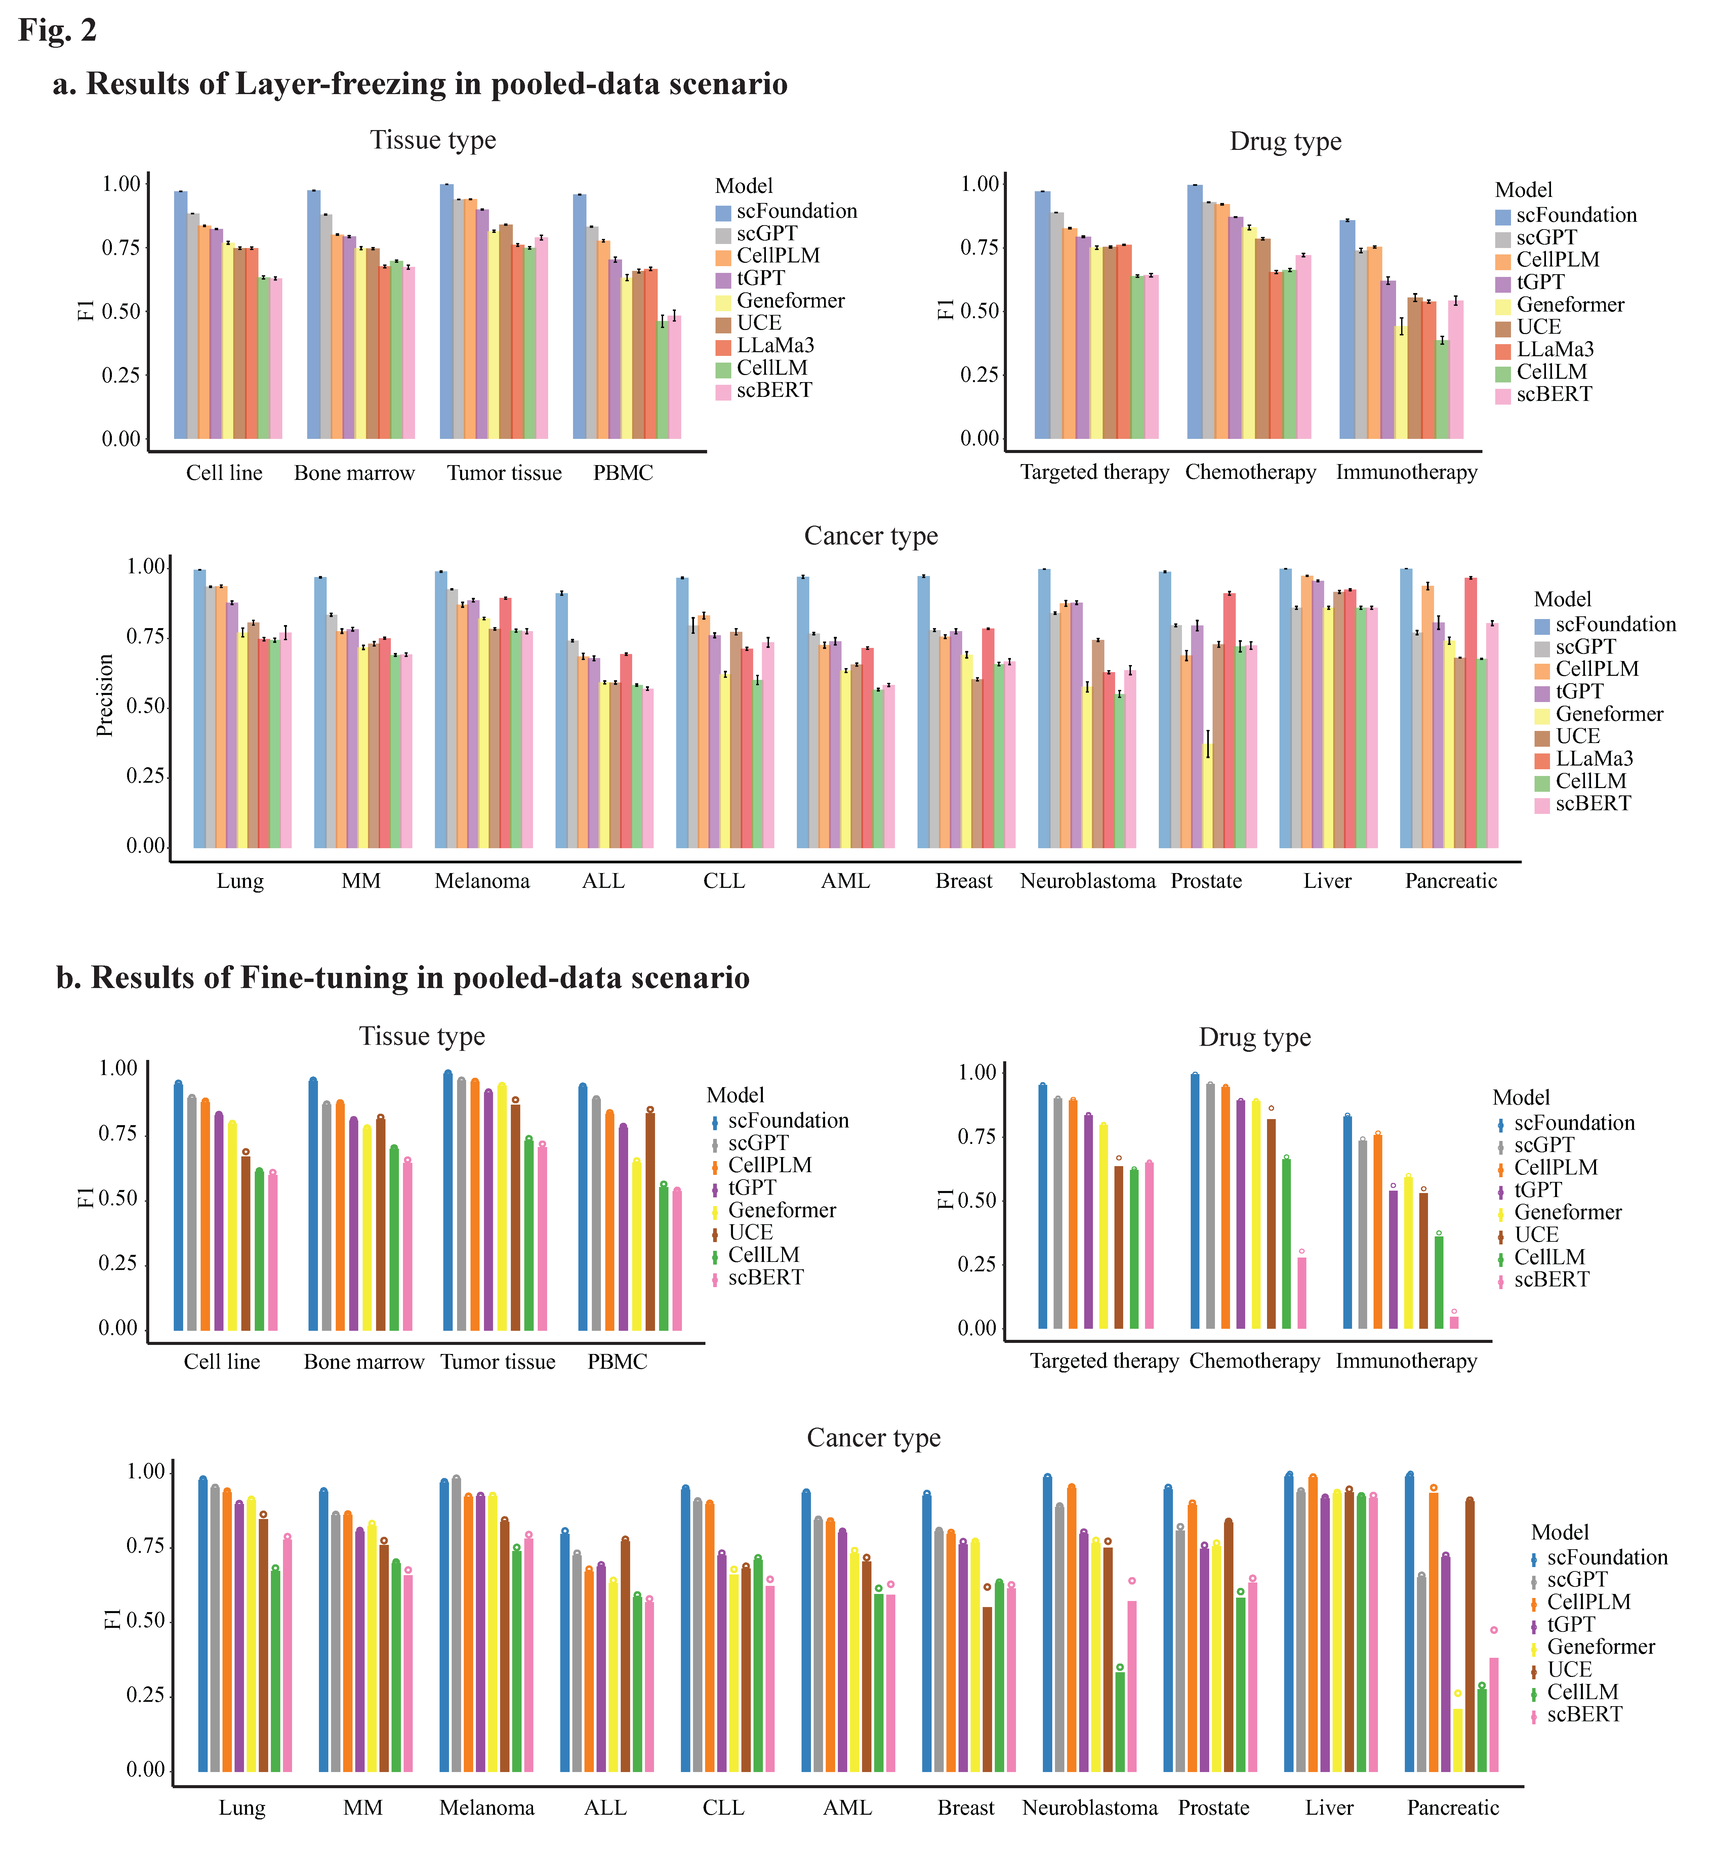
scDrugMap: Benchmarking Large Foundation Models for Drug Response Prediction
Model performance in predicting drug response in pooled-data evaluation using primary single-cell data

Slide 32
scDrugMap: Benchmarking Large Foundation Models for Drug Response Prediction
Model performance in predicting drug response in pooled-data evaluation using primary single-cell data

Slide 33
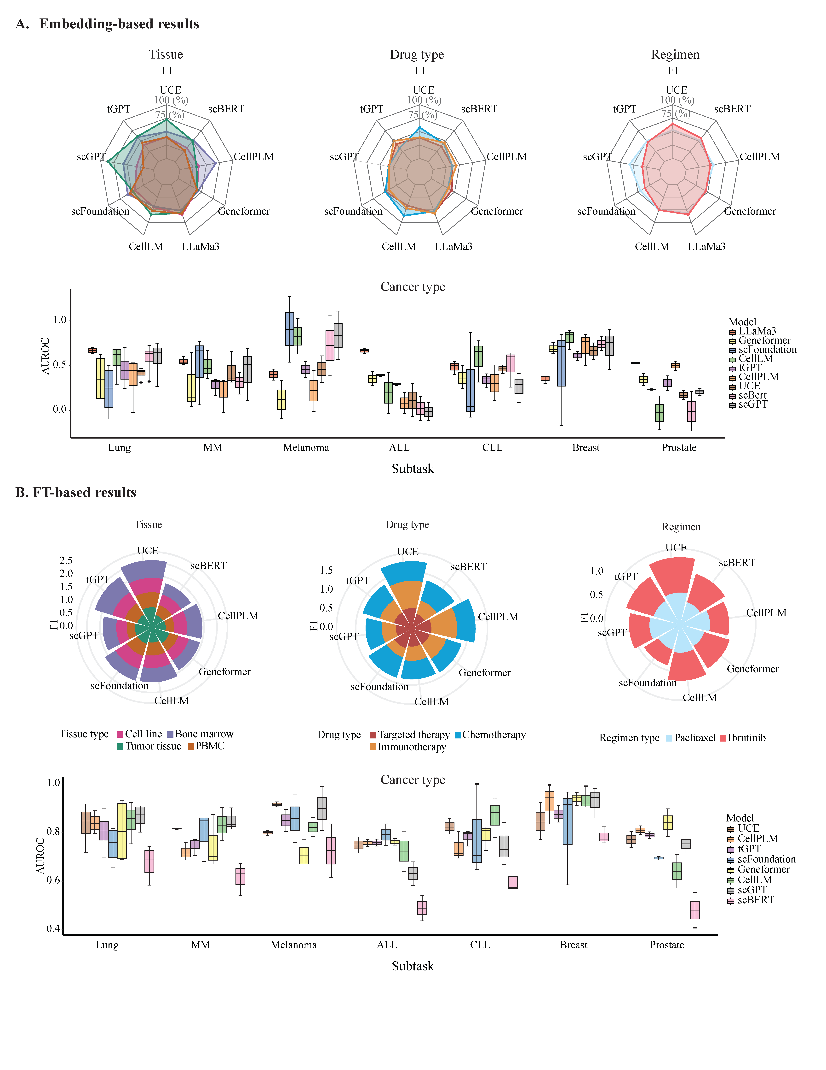
scDrugMap: Benchmarking Large Foundation Models for Drug Response Prediction
Model performance in predicting drug response in cross-data evaluation using primary single-cell data.

Slide 34
scDrugMap: Benchmarking Large Foundation Models for Drug Response Prediction
Model performance in predicting drug response in cross-data evaluation using primary single-cell data.

Slide 35
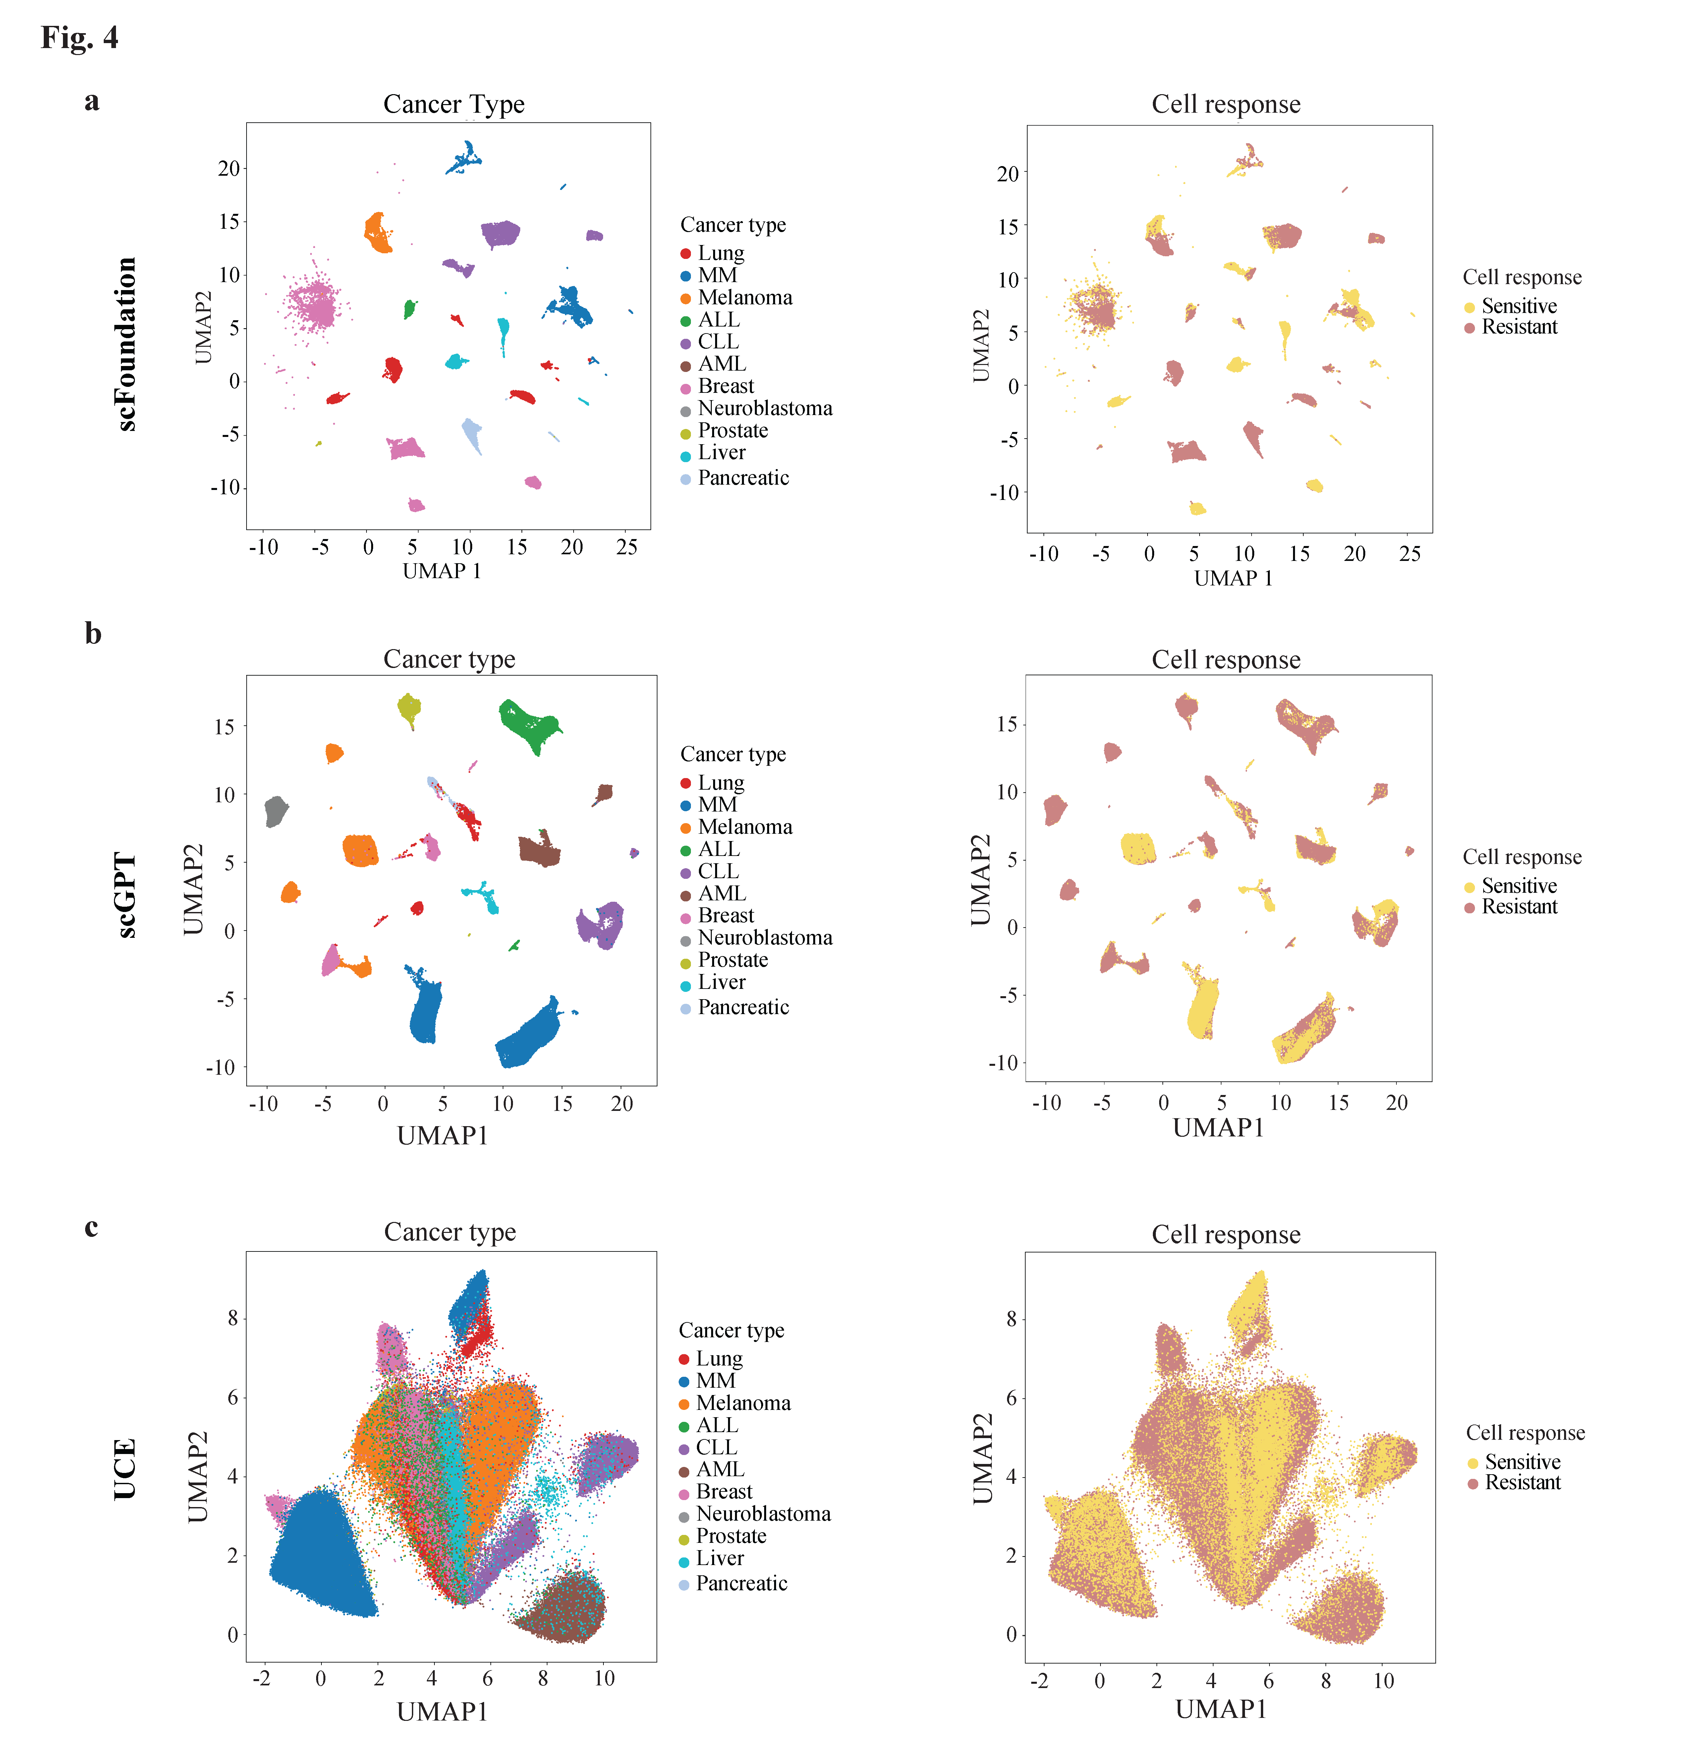
scDrugMap: Benchmarking Large Foundation Models for Drug Response Prediction
UMAP projection of primary single-cell data by different methods.

Slide 36

scDrugMap: Benchmarking Large Foundation Models for Drug Response Prediction
Performance of GPT4o-mini with zero-shots prediction in pooled-data evaluation using primary single-cell data.

Slide 37
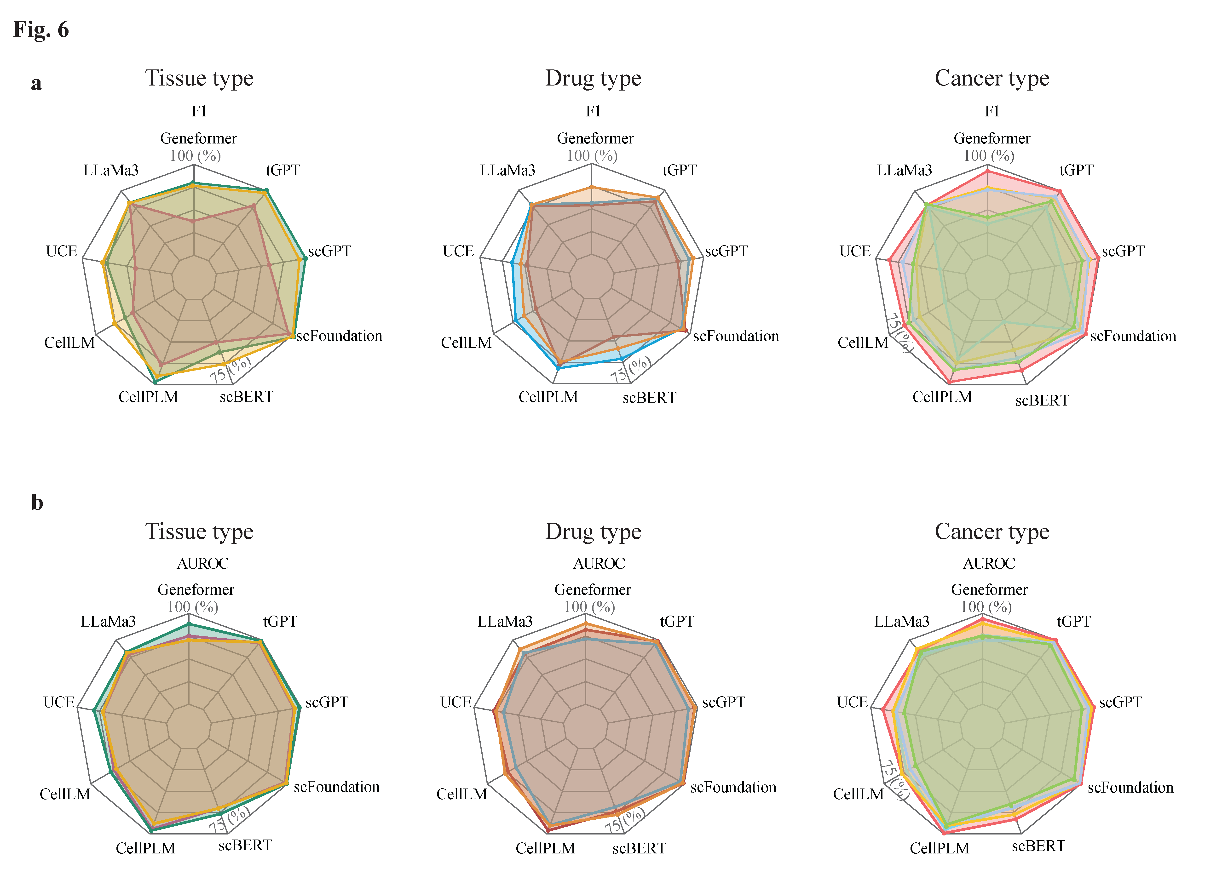
scDrugMap: Benchmarking Large Foundation Models for Drug Response Prediction
Model performance in predicting drug response using the validation data collection.

Slide 38
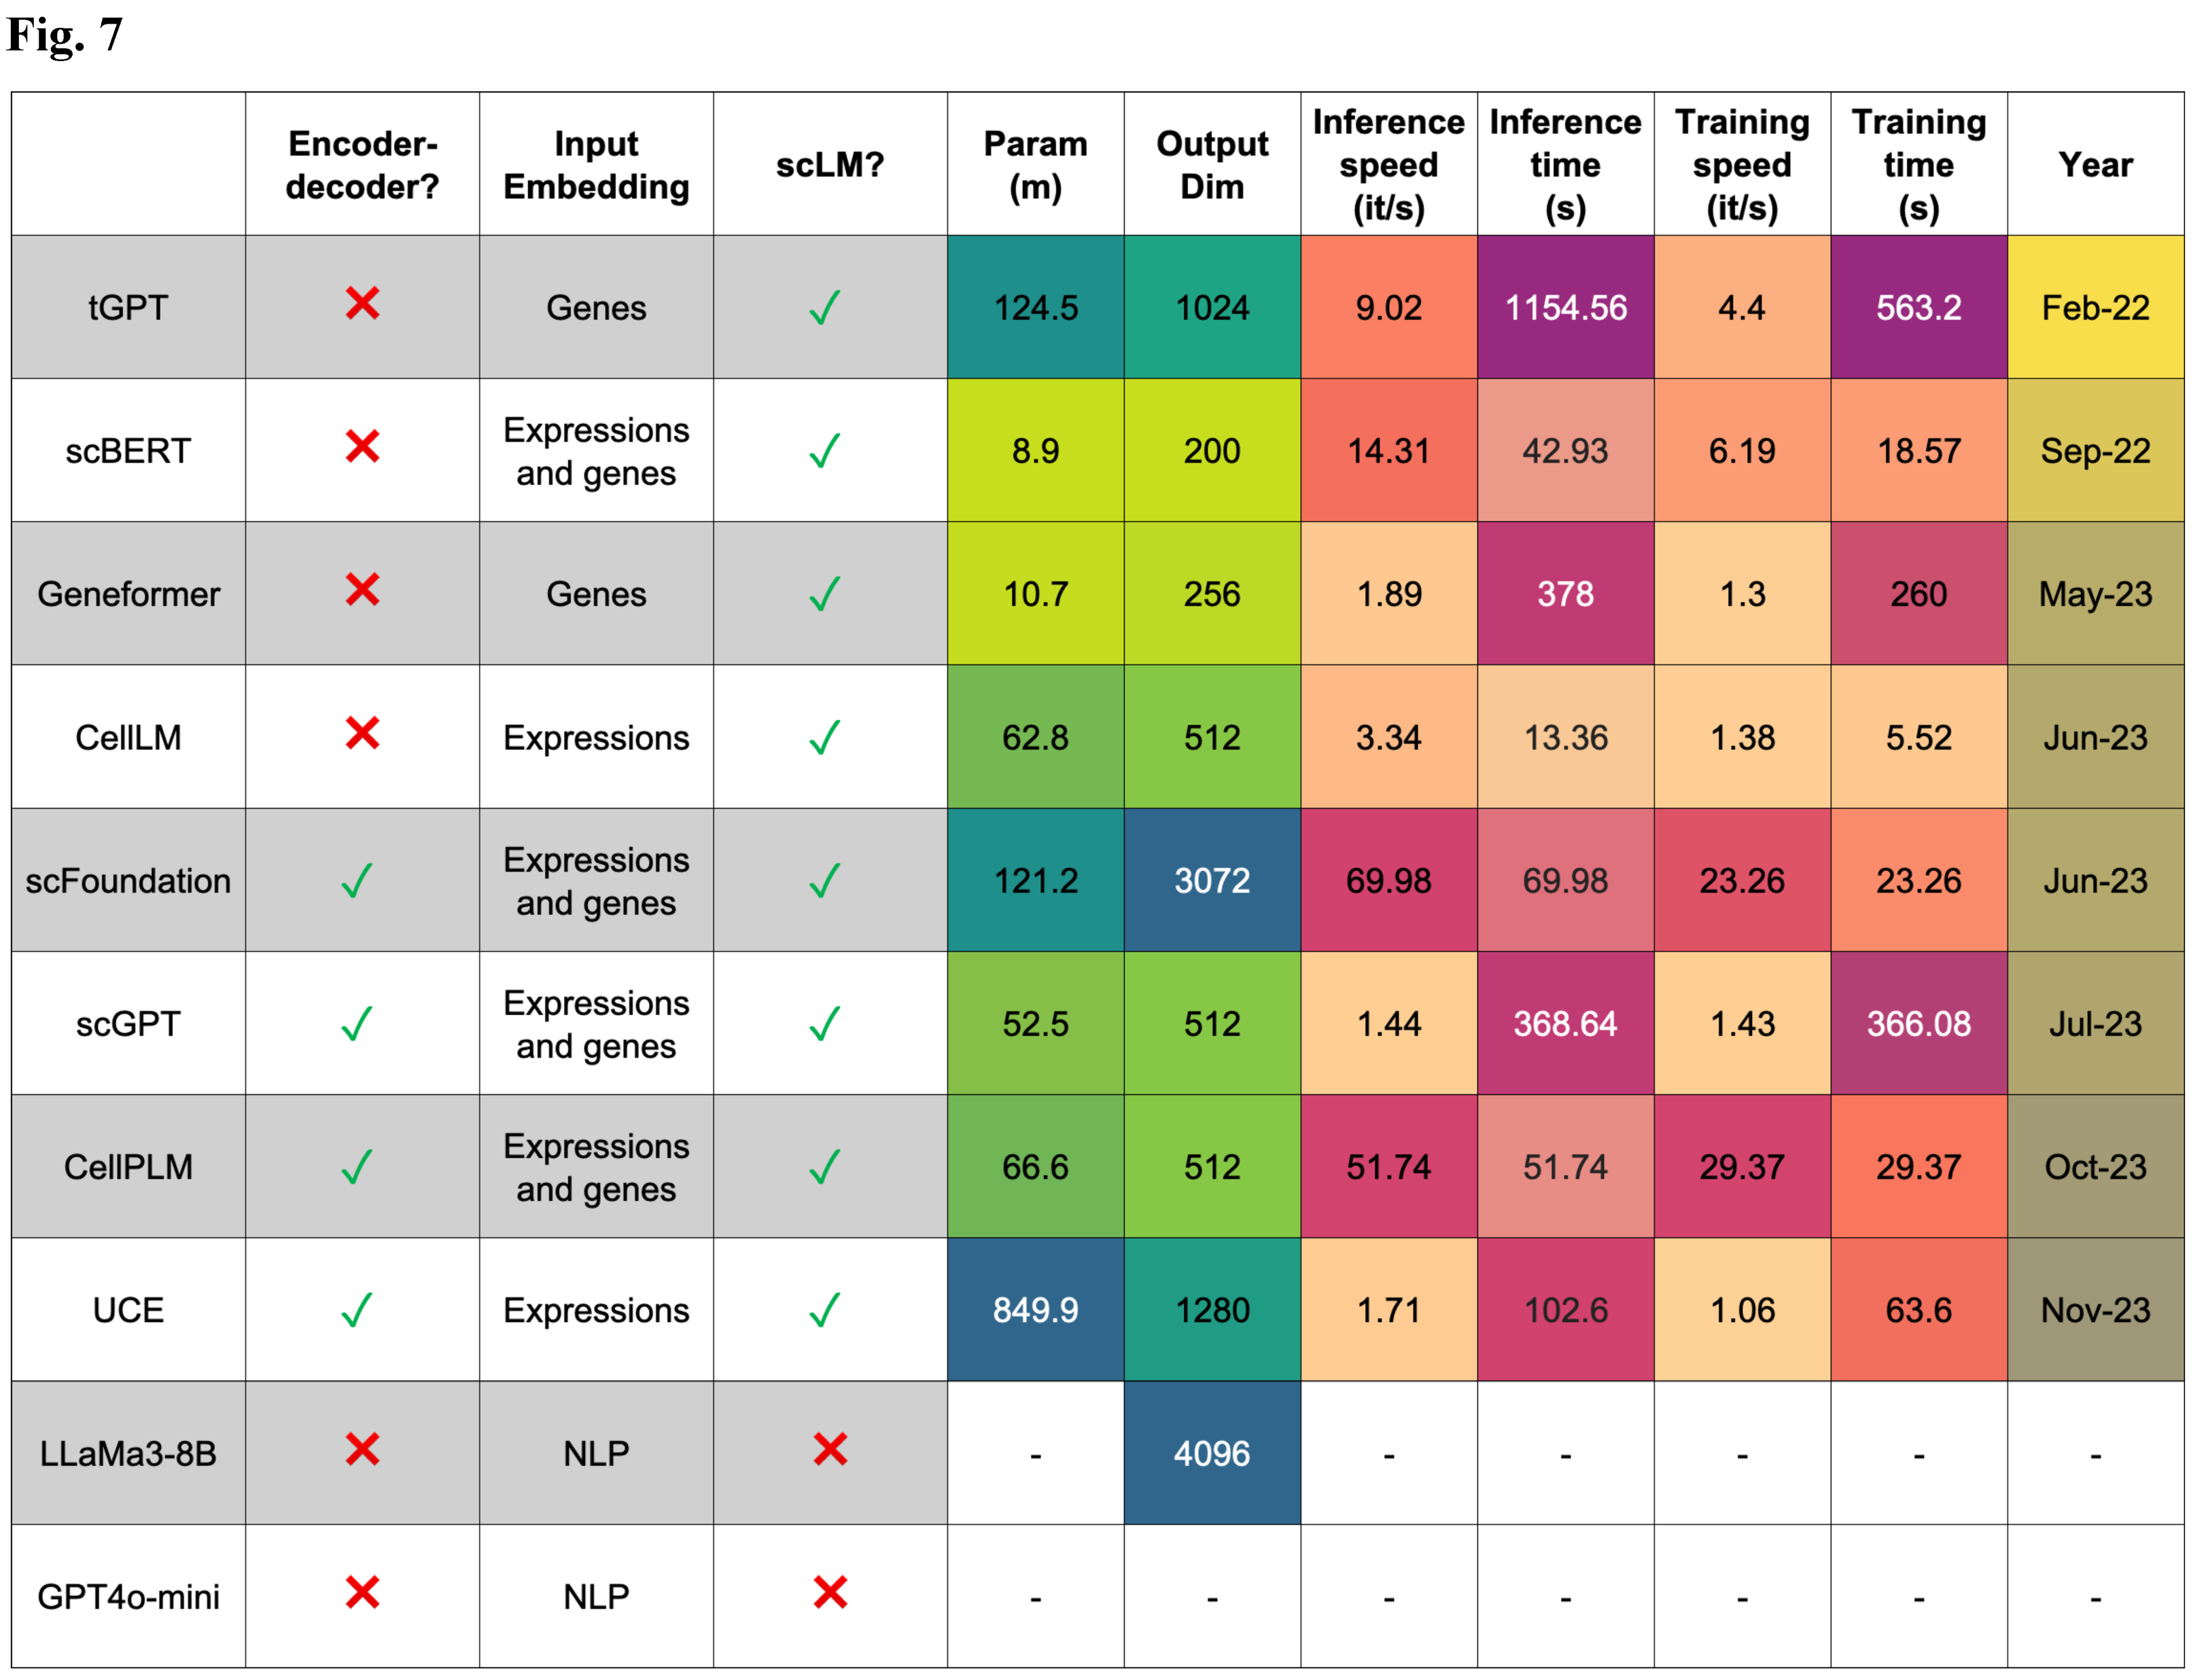
scDrugMap: Benchmarking Large Foundation Models for Drug Response Prediction
Summary of properties, computational efficiency, and scalability of each evaluated model.

Slide 39

scDrugMap: Benchmarking Large Foundation Models for Drug Response Prediction
PubMed
GitHub
aXiv
…
scDrug Agentic System
Self-benchmarking
Self-reasoning
Self-evolving
Literature
scGPT
scFoundation
UCE
STATE
…
DRMref
scDrugAtlas
scPerturb
…
Tool
Data

Slide 40
Key Takeaways
Comprehensive Data Resource: Established DRMref, the largest single-cell cancer drug resistance reference map, covering 42 datasets and 1.6 million cells.
Comprehensive Data Resource: Established DRMref, the largest single-cell cancer drug resistance reference map, covering 42 datasets and 1.6 million cells.
Innovative Predictive Model: Developed DrugFormer, a graph-enhanced transformer model that sets a new standard for single-cell drug sensitivity prediction.
Systematic Benchmarking: Created scDrugMap, a multi-dimensional benchmark to evaluate 10 large foundation models in the context of drug response.
scDrug Agentic System: Automated end-to-end single-cell drug response analysis system.

Slide 41
Thanks & QA
Contact: wang.qing@ufl.edu

